Slide 1
New Rules: Scaling Performance for Extreme Scale Computing
S. Yalamanchili
School of Electrical and Computer Engineering
Georgia Institute of Technology
Atlanta, GA. 30332
Sponsors: National Science Foundation, Sandia National Laboratories, Semiconductor Research Corporation, and IBM
Notes:
1

Slide 2
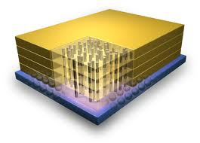
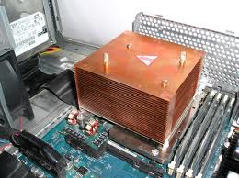
Scaling Computing
Hybrid Memory Cube
Cray Titan

Slide 3
Outline
Performance Scaling Rules & Constraints
Case Study: CPU-GPU Coordinated Power Management
Some New Projects
MIDAS – Cooling-Power-Microarchitecture Co-Design
Hardware/Software Reliability Enhancement
Adaptive Architectures

Slide 4
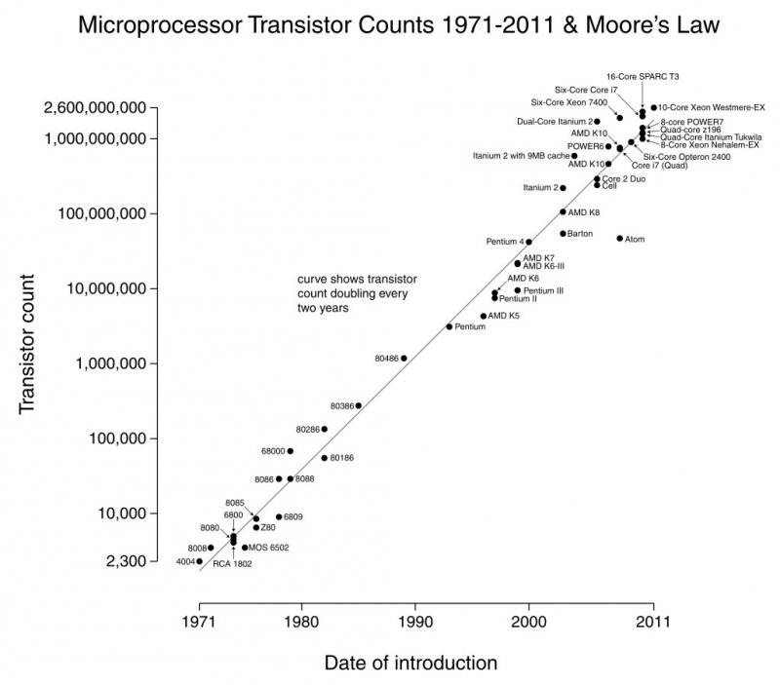
Moore’s Law
Goal: Sustain Performance Scaling
Performance scaled with number of transistors
Dennard scaling: power scaled with feature size
From wikipedia.org

Slide 5
Post Dennard Architecture Performance Scaling
Power Delivery
Cooling
W. J. Dally, Keynote IITC 2012
Data_movement_cost
Three operands x 64 bits/operand

Slide 6
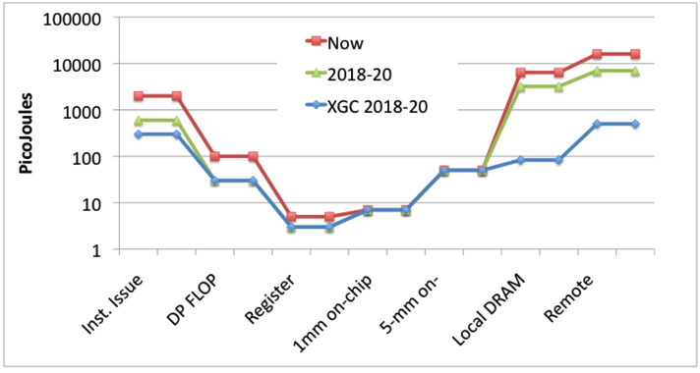
Scaling Performance: Cost of Data Movement
Embedded Platforms
Big Science: To Exascale
Cost of Data Movement
Goal: 1-100 GOps/w
Goal: 20MW/Exaflop
Courtesy: Sandia National Labs :R. Murphy.
Sustain performance scaling through massive concurrency
Data movement becomes more expensive than computation

Slide 7
Post Dennard Architecture Performance Scaling
W. J. Dally, Keynote IITC 2012
Operator_cost + Data_movement_cost
Three operands x 64 bits/operand
Specialization → heterogeneity and asymmetry

Slide 8
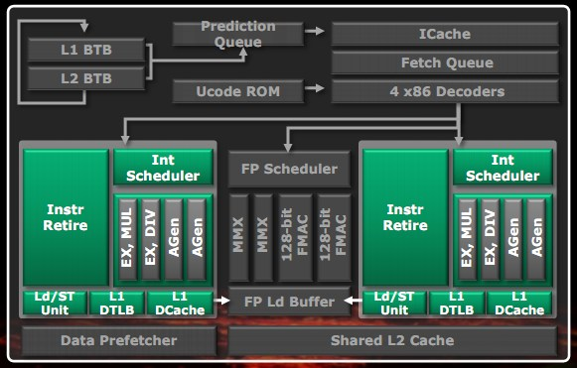
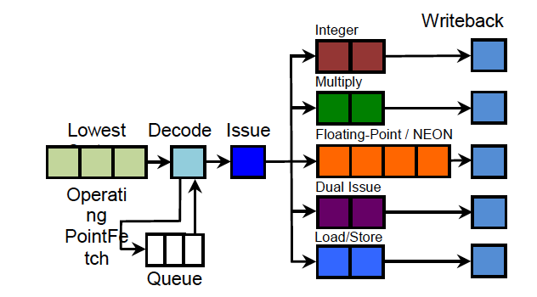
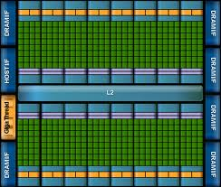
Scaling Performance: Simplify and Multiply
AMD Bulldozer Core
Extracting single thread performance costs energy
Out-of-order execution
Branch prediction
Scheduling etc.
Still important!
ARM A7 Core (arm.com)
Multithread performance exploits parallelism
Simpler pipelines
Core scaling
NVIDIA Fermi

Slide 9
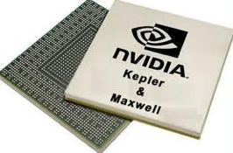
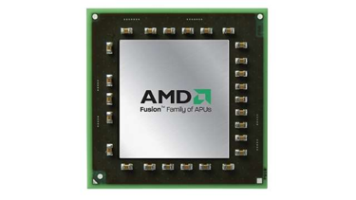
Asymmetry vs. Heterogeneity
Performance Asymmetry
Functional Asymmetry
Heterogeneous
MC
Tile
Tile
Tile
Tile
MC
MC
Tile
Tile
MC
Tile
Tile
Tile
Tile
Tile
Tile
MC
Tile
Tile
Tile
Tile
MC
MC
Tile
Tile
MC
Tile
Tile
Tile
Tile
Tile
Tile
Multiple voltage and frequency islands
Different memory technologies
STT-RAM, PCM, Flash
Complex cores and simple cores
Shared instruction set architecture (ISA)
Subset ISA
Distinct microarchitecture
Fault and migrate model of operation¹
Multi-ISA
Microarchitecture
Memory & Interconnect hierarchy
Uniform ISA
Multi-ISA
¹Li., T., et.al., “Operating system support for shared ISA asymmetric multi-core architectures,” in WIOSCA, 2008.
Notes:
Asymmetry is below the ISA and is both design time as well as operational (DVFS, reconfigurable). Now we will focus on heterogeneity and not asymmetry. What has changed here? Use the SCC figure here. 8 voltage and 28 frequency islands. Each tile can run at a different frequency. 6 banks of four tiles can run at different voltages, independent V7F control for I/O network and MCs

Slide 10
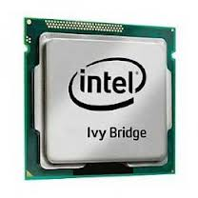
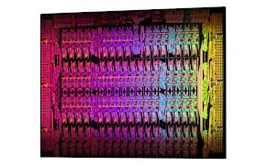
The Challenge: The Memory System
H. Kim (SCS) and S. Yalamanchili (ECE)
Sponsor: Sandia National Labs
Xeon Phi
Hybrid Memory Cube
What should the memory hierarchy look like?
Parallelism vs. locality tradeoffs
Minimize data movement → Processor in Memory?

Slide 11
Thermal Capacity
Exploit package physics
Temperature changes on the order of milliseconds
Workload behaviors change on the order of microseconds
Impact on device behavior?
Thermal Capacity
Time Varying Workload
Instructions/cycle
Power-Performance Management!
Time
Figures: psdgraphics.com and wikipedia.org

Slide 12
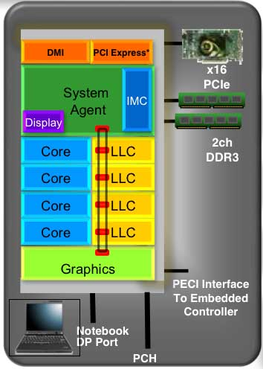
Adapting to Power + Thermal Constraints
Exploit package physics
Temperature changes on the order of milliseconds
Use the thermal headroom
Intel Sandy Bridge
Turbo boost region
Max Power
TDP Power
10s of seconds
Low power – build up thermal credits
Time
E. Rotem, et.al., Power-management Aarchitecture of the Intel Microarchitecture code-named Sandy Bridge, IEEE Micro March 2012

Slide 13
Summary: New Performance Scaling Rules
Energy efficiency: Scale performance by scaling energy efficiency → diversify → programming models?
Parallelism: Scale number of cores rather than performance of a single core → multiply
Data Movement: Energy cost of data movement is more expensive than the energy cost of computation → communication-centric
Physics Capacity: Scaling limited by thermal/power capacity → power management

Slide 14
Physics of Computation
Physical phenomena interact with architecture to affect system level metrics such as energy, power, performance and reliability
These interactions are modulated by workloads
Need management techniques that can improve energy efficiency

Slide 15
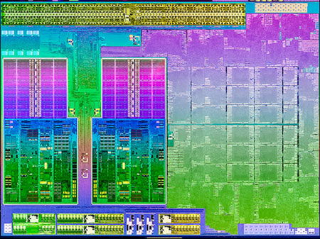
Thermal Coupling
I. Paul et.al., (ISCA 2013)
GPU
CU0
CU1
AMD Trinity APU
Thermal coupling between CPU and GPU leads to inefficient operation
Interaction with power management, e.g., turbo core/boost reduces efficiency

Slide 16
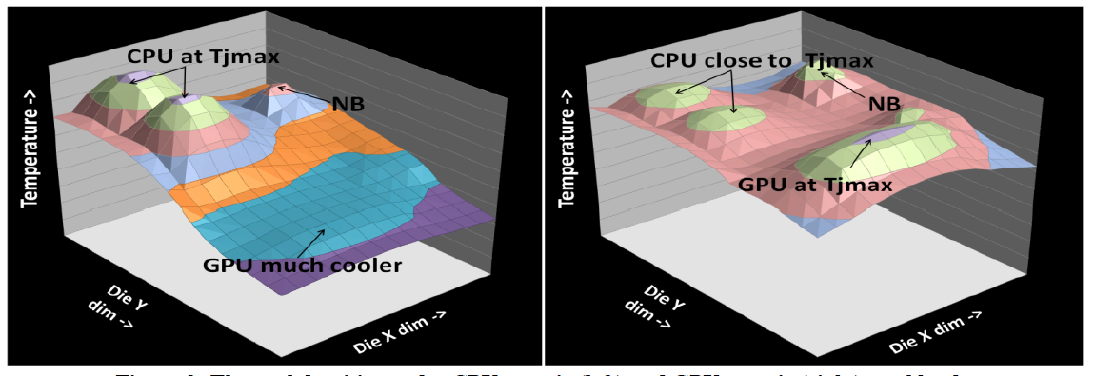
Thermal Signatures and Fields
Measurements on an AMD Trinity A8-4555M APU
CPUs are more thermally dense
Thermal gradient from CPUs to GPU
GPU temperature rise due thermal pollution
Premature throttling and hence performance loss

Slide 17
Thermal Coupling
GPU
CU0
CU1
AMD Trinity APU
Thermal coupling between CPU and GPU accelerates temperature rise
Solution → Cooperative Boosting

Slide 18
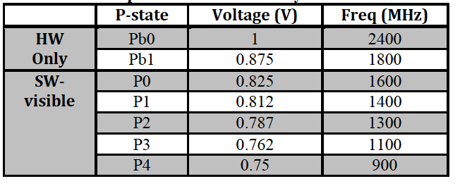
CPU Core Performance States: AMD Trinity APU

Slide 19
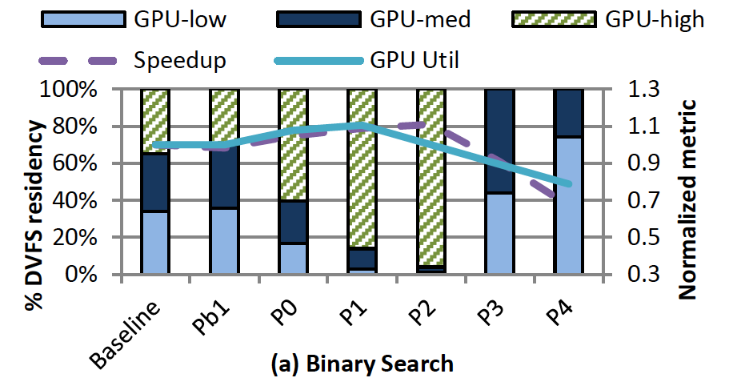
Performance Coupling Effects
Need to balance performance coupling and thermal coupling effects

Slide 20
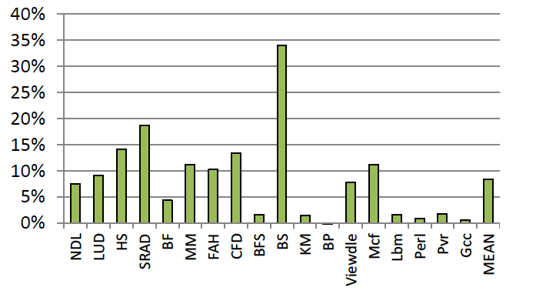
Power Savings Using CB

Slide 21
Energy-Delay²

Slide 22
Related Projects

Slide 23
MIDAS
M. Bakir (ECE), H. Kim (SCS), Y. Joshi (ME), S. Mukhopadhyay (ECE),
S. Yalamanchili (ECE)
Emulating the Physics
Multi-scale Transient Models for
Coupled Multi-physics
Probe Stations: Chip and Board Level Probe, Test, & Power Measurement
FPPE
Functional simulator (Apps, OS)
PDN Model
On-Demand Cooling
Power Model
Thermal Model
Advanced micro-fabrication for microfluidics
Cycle-Level Multicore Timing Simulator
Microarchitecture Optimization
Globally Transient Adaptations
Co-Design
System Arch. Impact
Power Distr. Network
Power Management
CPU core
CPU core
CPU core
Novel Cooling Technology
GPU
Locally transient
Adaptations
cache
cache
cache
CPU core
CPU core
CPU core
MIDAS Tasks
FPGA Implementation
Indicates existing infrastructures/models

Slide 24
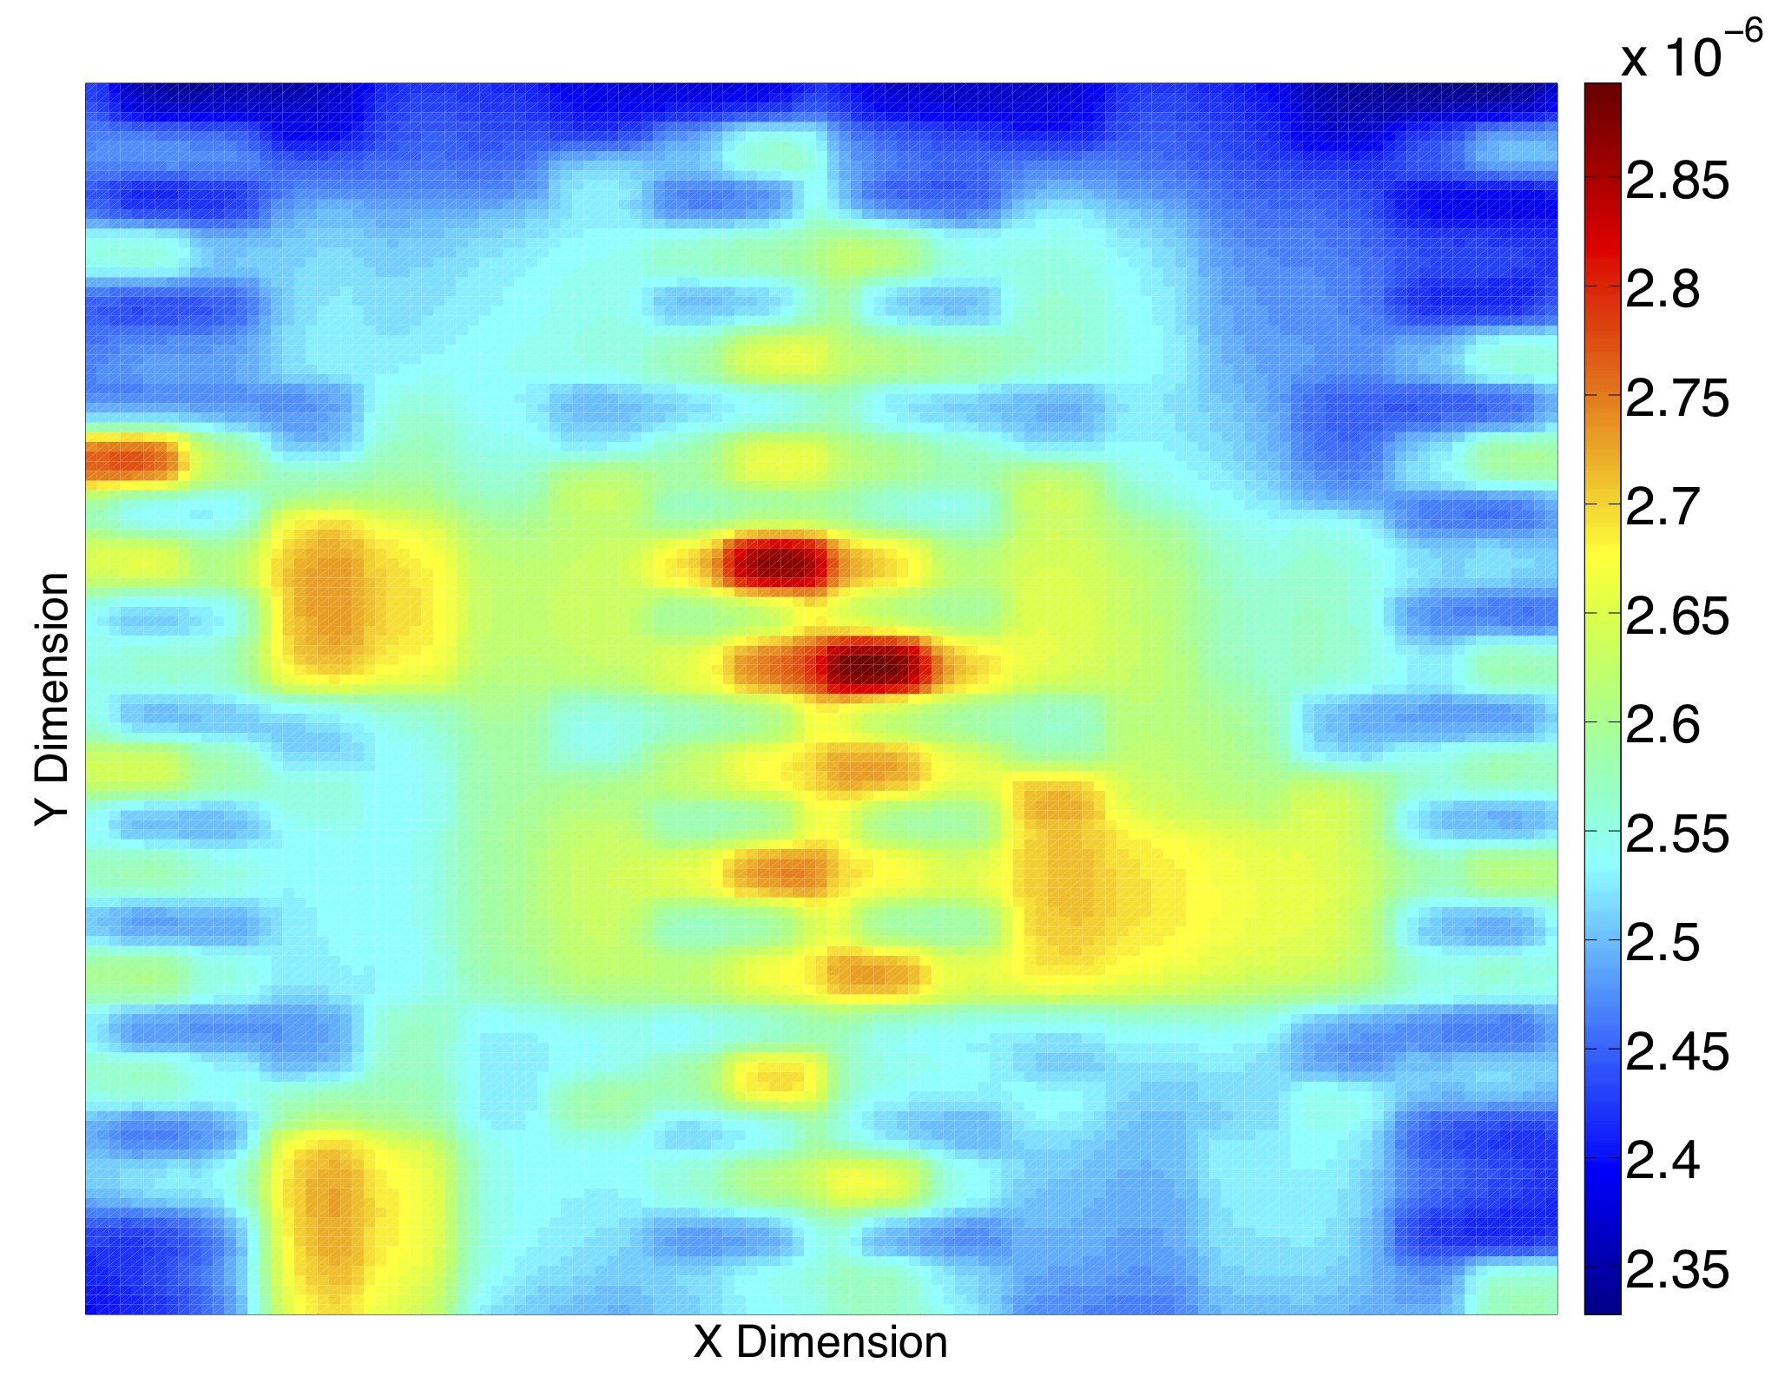
Reliability Enhancement - Microarchitecture
S. Yalamanchili (ECE) and S. Mukhopadhyay (ECE)
Sponsor: SRC (IBM)
Single-core processor lifetime reliability
Multicore processor lifetime reliability
In-order core
Out-of-order core
x10⁻¹⁰
Peak temperature and MTTF analysis from J. Srinivasan et al., “Lifetime Reliability: Toward An Architectural Solution,” Micro 2005.
64-core asymmetric chip multiprocessor layout and failure probability distribution
25% peak-to-peak difference of failure distribution across the processor die; induced by architectural asymmetry, thermal coupling, power management, and workload characteristics

Slide 25
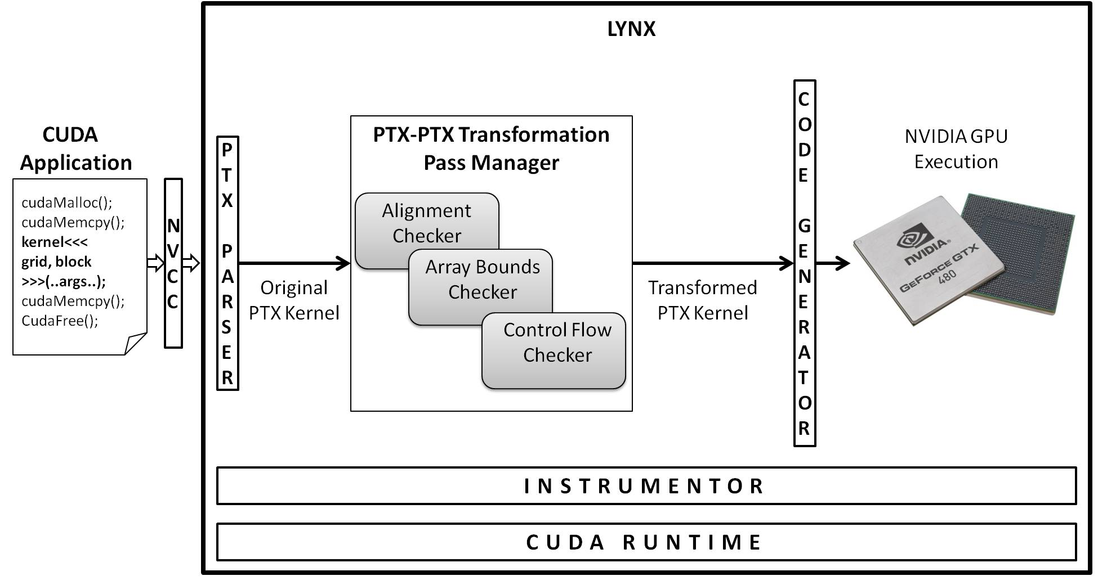
Reliability Enhancement - Software
S. Yalamanchili (ECE) and K. Schwan (SCS)
Sponsor: NSF
Key Idea: low level code injection
Framework:
On-demand
Customizable
Transparent
Examples:
Alignment check
Bounds check
Control flow check
Notes:
Stand-in picture to fill white space

Slide 26
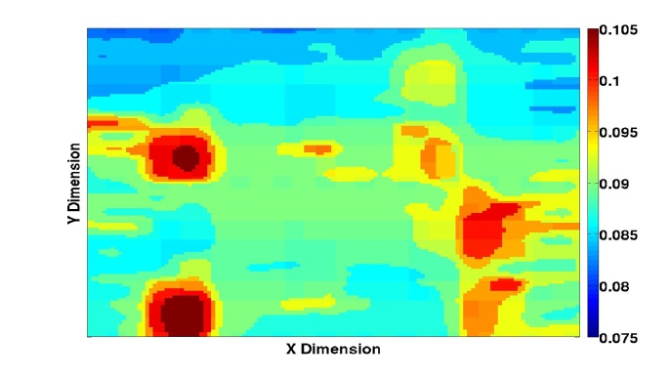
Adaptive 3D Architecture
S. Yalamanchili (ECE) and S. Mukhopadhyay (ECE)
Sponsor: SRC
Applications and Threads
1. Workload Characterization
workload (w(t))
Manifold
Functional simulator (Apps, OS)
4. Microarchitectural Adaptation Mechanisms
Memory
PDN Model
Reliability
Power & Thermal Model
Memory
Memory
Cycle-Level Multicore Timing Simulator
Memory
CPU core
CPU core
CPU core
Network
GPU
cache
cache
cache
Many Core Processor
CPU core
CPU core
CPU core
3. Explore Architecture Design Space
2. Characterize Interacting Physical Effects

Slide 27
Summary
Architecture
Applications
System Software
The physical phenomena should not be masked, but rather integrated into the design
We need tightly coupled integrated models of software, algorithms, architecture and technology
Technology

Slide 28
Thank You
Questions?
28

