Slide 1
Red Fox: An Execution Environment for Data Warehousing Applications on GPUs
Haicheng Wu¹, Gregory Diamos², Tim Sheard³, Molham Aref⁴,
Sudhakar Yalamanchili¹
¹Georgia Institute of Technology
²NVIDIA
³Portland State University
⁴LogicBlox, Inc.
Sponsors: National Science Foundation, LogicBlox Inc. , and NVIDIA
Notes:
1

Slide 2
Data Warehousing Applications on GPUs
The Opportunity
Significant potential data parallelism
If data fits in GPU memory, 2x—27x speedup has been shown ¹
The Challenge
Need to process 1-50 TBs of data²
15–90% of the total time* spent in moving data between CPU and GPU *
Fine grained computation
1 B. He, M. Lu, K. Yang, R. Fang, N. K. Govindaraju, Q. Luo, and P. V. Sander. Relational query co-processing on graphics processors. In TODS, 2009.
2 Independent Oracle Users Group. A New Dimension to Data Warehousing: 2011 IOUG Data Warehousing Survey.

Slide 3
Red Fox: Goal and Status
Goal
Build a compiler/runtime framework to accelerate Datalog^{LB} query by GPUs
To find out What is good? What is bad? What is ugly?
Status
The only system in the world that is capable of running full TPC-H queries in GPUs
Require data fits the GPU memory
Focus on correctness
Use Jeff’s Oncilla GAS framework to run large data set in the future

Slide 4
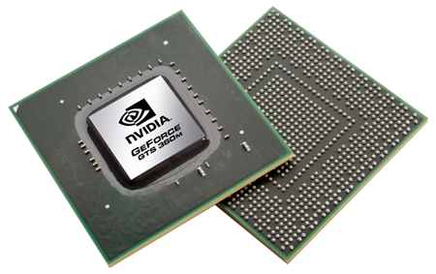
Red Fox Compilation Flow (submission PACT 2013)
Datalog^{LB} Queries
RA Primitives Library
Language
Front-End
RA-to-PTX
(nvcc + RA-Lib)
Runtime
Kernel Weaver
Language Front-End
Translation Layer
Back-End
Query Plan
Harmony IR
RA – Relational Algebra
PTX – Parallel Thread Execution

Slide 5
Datalog^{LB} Query and Front-end
Example Datalog^{LB} Query
Example Query Plan (CFG)
1 number(n)->int32 (n) .
2 number(0).
3 // other number facts elided for brevity
4 next(n,m)->int32(n), int32(m).
5 next(0,1).
6 // other next facts elided for brevity
7
8 even(n)-> int32(n).
9 even(0).
10 even(n)<-number(n),next(m,n),odd(m).
11
12 odd (n)->int32(n).
13 odd (n)<-next(m,n),even(m).
Recursive Definition
Recursive Definition
Translated to
Loops
Front-end

Slide 6
RA Primitives Library: In-Core Algorithm Design
Strategy: Increase core utilizations until the computation becomes memory bound, and then achieve near peak utilization of the memory interface
Hybrid multi-stage algorithm (partition, compute, gather) to make trade-offs between computation complexity and memory access efficiency
Each Primitive has 1-3 CUDA kernels
* G. Diamos, H. Wu, J. Wang, A. Lele, and S. Yalamanchili. Relational Algorithms for Multi-Bulk-Synchronous Processors. In PPoPP, 2013.

Slide 7
RA Primitives Library: Raw Performance
Most complicated JOIN: 57%~72% peak performance
Most efficient PRODUCT, PROJECT and SELECT: 86%~92% peak performance
Best published results
Measured on Tesla C2050
Random Integers as inputs
* G. Diamos, H. Wu, J. Wang, A. Lele, and S. Yalamanchili. Relational Algorithms for Multi-Bulk-Synchronous Processors. In PPoPP, 2013.

Slide 8
RA-to-PTX Compiler
Map Operators to GPU implementations
From Thrust Library
SORT
UNIQUE
AGGREGATION
SET Family
From RA Library
PROJECT
PRODUCT
SELECT
JOIN
Data Structure: weekly sorted arrays of densely packed tuples
id
price
tax
padding zeros
4 bytes
8 bytes
……
16 bytes
Key
Value
Tuple fields can be integer, float, datetime, string, etc.

Slide 9
RA-to-PTX Compiler: Example
Example Query Plan (CFG)
Example Harmony IR (CFG)
RA-to-PTX

Slide 10
Kernel Weaver: Automatically Applying Kernel Fusion
A1
A2
A1
A2
A3
Before Fusion
Kernel A
A3
After Fusion
Fused Kernel A , B
Temp
Kernel B
Result
Result
GPU MEM
GPU Core
GPU MEM
GPU Core
A1
A1
A1
A1
Temp
Temp
Temp
A2
A2
A2
A2
A3
A3
A3
A3
Result
Result
Result
Result
Kernel A
Kernel B
Fused Kernel A&B

Slide 11
Kernel Weaver: Major Benefits
Reduce Data Footprint
Reduction in accesses to global memory
Access to common data across kernels improves temporal locality
Reduction in PCIe transfers
Expand optimization scope of the compiler
Data re-use
Increase textual scope of optimizers
A1
A2
A1
A2
A3
Kernel A
A3
Fused Kernel A , B
Temp
Kernel B
Result
Result
* H. Wu, G.Diamos, S.Cadambi, and S. Yalamanchili. Kernel Weaver: Automatically Fusing Database Primitives for Efficient GPU Computation. In MICRO 2012.

Slide 12
Kernel Weaver: Micro-benchmarks
If fusing below operators together on Tesla C2070
Fused vs. Not Fused
Average 2.89x speedup

Slide 13
Runtime
Launch kernels
Launch PTX kernels via CUDA driver
Launch Thrust kernels via LLVM
Allocate/Free GPU memory on Demand to save GPU space
Transfer initial raw data and final result
Profiling the performance

Slide 14
Experimental Environment
CPU | Xeon X5560 @ 2.80GHz
GPU | 1 Tesla C2075 (6GB GDDR5 memory)
OS | Ubuntu 10.04 Server
GCC | 4.6.1
NVCC | 4.2
Thrust | 1.5.2

Slide 15
TPC-H Queries
A popular decision making benchmark suite
Have 22 queries analyzing data from 6 big tables
Scale Factor parameter to control database size
Red Fox can run SF=1 for all 22 queries

Slide 16
TPC-H Performance (SF = 1)
Raw performance of each query is in the Pact submission
22 queries totally takes 67.40 seconds
Compared with MySQL implementation in 4 node CPU cluster*, Red Fox is 59x faster on average
Execution time = PCIe + GPU Computation
No data movement optimizations
Unoptimized query plan
*Ngamsuriyaroj, Pornpattana, “Performance Evaluation of TPC-H Queries on MySQL Cluster.” WAINA 2010.

Slide 17
Where is the time spent?
Most of time is spent in JOIN and SORT
PCIe transfer time is less than 10%
PROJECT used most frequently, but takes less than 5%

Slide 18
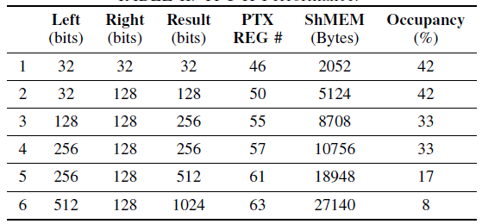
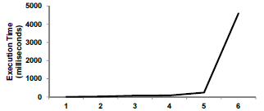
The impact of tuple size
6 JOINs in Q1

Slide 19
Future Improvements
Fix Errors in Datalog queries and query plans
Optimized query plan
Reduce tuple size
Common operator reduction
Reorder operators (e.g. SELECT before JOIN)
More RA implementations
Hash Join
Radix Sort
NVIDIA new implementation of merge sort and merge join
Multiple predicate join
String operations and other built-in functions
Pipeline the execution
Expect 10x-100x speedup from above techniques

Slide 20
Conclusions
Red Fox system progressively parses and lowers Datalog^{LB} queries into different IRs and finally runs them in GPUs
Evaluate Red Fox with full TPC-H queries
Significant speedup compared with CPUs
Most time spent in SORT and JOIN
GPU memory capacity restricts the problem size
Current work:
10-100x speedup with relational optimization and new operator algorithms
Run large data set

Slide 21
Thank You
Questions?
21

Slide 22
Backup
22

Slide 23
Relational Algebra (RA) Operators
RA operators are the building blocks of DB applications
Set Intersection
Set Union
Set Difference
Cross Product
Join
Select
Project
Example: Select [Key == 3]
Key | Value
3 | True, a
3 | False, b
4 | True, a
Key | Value
3 | True, a
3 | False, b
4 | True, a

Slide 24
Relational Algebra (RA) Operators
RA are building blocks of DB applications
Set Intersection
Set Union
Set Difference
Cross Product
Join
Select
Project
Example: Join
New Key = Key(A) ∩ Key(B)
New Vallue = Value(A) U Value(B)
Key | Value
3 | a
3 | b
4 | a
Key | Value
3 | c
4 | d
5 | e
Key | Value
3 | a,c
3 | b,c
4 | a,d
A
B
JOIN (A, B)

