Slide 1
Detecting Transient Bottlenecks in n-Tier Applications through Fine-Grained Analysis
Qingyang Wang
Advisor: Calton Pu
Notes:
Good morning everyone, I’m Qingyang Wang from Dr. Calton Pu’s research group. The topic of my today’s presentation is Detecting Transient….

Slide 2
Response Time is Important
Response time is an important performance factor for Quality of Service (e.g., SLA for web-facing e-commerce applications).
Experiments at Amazon show that every 100ms increase in the page load decreases sales by 1%.
Akamai reported that 40% of users expect a website to load in 2 seconds or less.
Source: [K. Ron et al., IEEE Computer 2010]
Notes:
Response time is an important performance factor for Quality of Service of web-facing e-commerce applications.
Experiments at Amazon show that every 100ms increase of response time decreases sales by 1%
Akamai also reported that 40% of users expect a website to load in 2 seconds or less.

Slide 3
Transient Bottlenecks in n-Tier Web Applications
Transient bottlenecks may cause wide-range end-to-end response time fluctuations and lead to severe SLA violations.
Traditional monitoring tools may not be able to detect transient bottlenecks due to their coarse granularity (e.g., one second).
We will show a motivational experiment of this phenomenon.
The goal of this research is to propose a novel transient bottleneck detection method.

Slide 4
Outline
Background & Motivation
Background
Motivational experiment
Method for Detecting Transient Bottlenecks
Trace monitoring tool
Fine-grained load/throughput analysis
Two Case Studies
Intel SpeedStep
JVM garbage collection
Conclusion & Future Works

Slide 5
Experimental Setup (1): Benchmark Application
RUBBoS benchmark
Bulletin board system like Slashdot (www.slashdot.org)
Typical 3-tier or 4-tier architecture
Two types of workload
Browsing only (CPU intensive)
Read/Write mix
24 web interactions
Notes:
This slide shows our benchmark application RUBBoS, RUBBoS benchmark is a bulletin board system like Slashdot
There are two types of workload, browse only and Read/write mix. In this research we mainly use Browse only workload.

Slide 6
Experimental Setup (2): Software Configurations
Software Stack
Hypervisor | VMware ESXi v5.0
Guest OS | RHEL Server 6.2 (64-bit, kernel 2.6.32)
Web Server | Apache-httpd-2.0.54
Application Server | Apache-Tomcat-5.5.17
Cluster middleware | C-JDBC 2.0.2
Database Server | MySQL-5.0.51a-Linux-i686-glibc23
Sun JDK | Jdk1.5.0_07, jdk 1.6.0_14
System monitor | Sysstat 10.0.0, esxtop 5.0
Notes:
This slide shows software configuration.
We run our experiments in Virtualized environment

Slide 7
Experimental Setup (3): Hardware and VM Configurations
ESXi Host Configuration
Model | Dell Power Edge T410
CPU | Quad-core Xeon 2.27GHz * 2 CPU
Memory | 16GB
Storage | 7200rpm SATA local disk
VM Configuration
Type | # vCPU | CPU limit | CPU shares | vRAM | vDisk
Large (L) | 2 | 4.52GHz | Normal | 2GB | 20GB
Small (S) | 1 | 2.26GHz | Normal | 2GB | 20GB
Notes:
This slide shows our hardware and VM configuration.
The machines we used for experiments are one of the latest Dell server models
3. We have two types of VMs, Large and small, each of which represents different processing power.

Slide 8
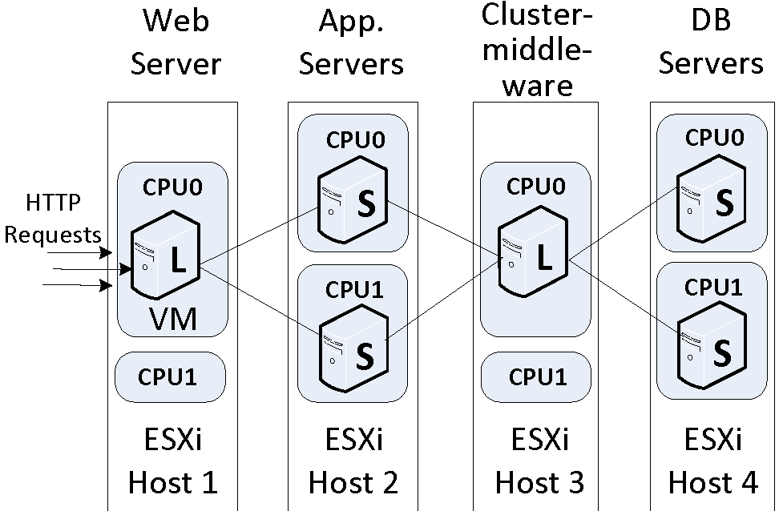
Experimental Setup (4): System Topology
Sample topology (1/2/1/2)
Notes:
This slide shows a sample topology 1/2/1/2, which means web server, two application servers, one CJDBC server and two database servers, each of the four tiers is deployed in one ESXi host.

Slide 9
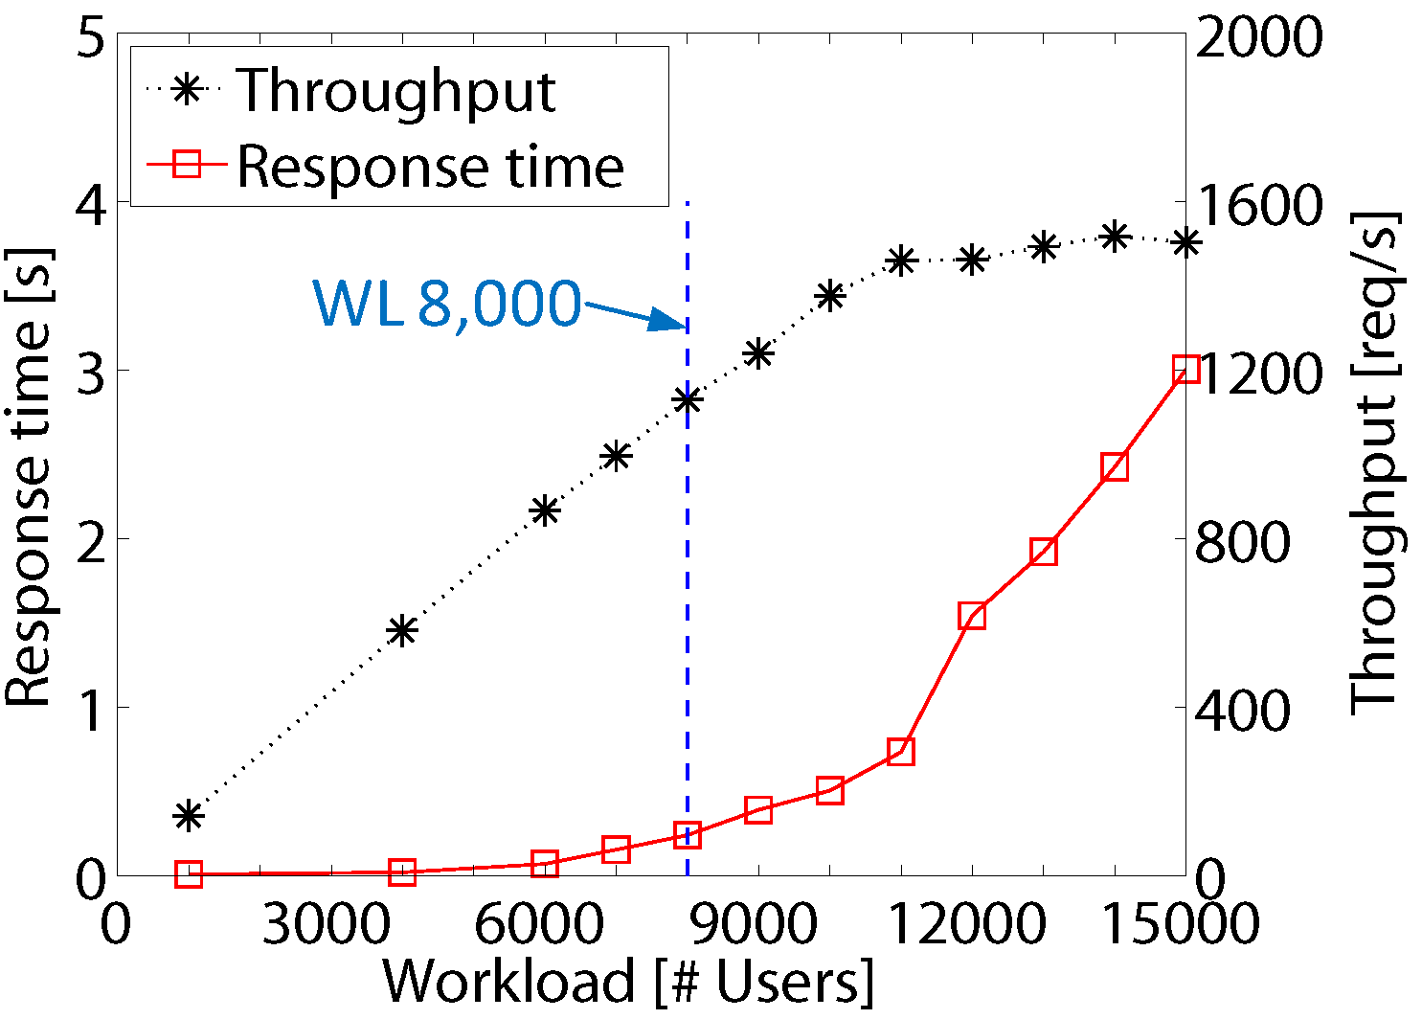
Motivational Example
Response time & throughput of a 10 minute benchmark on the 4-tier application with increasing workloads.
How does the system actually behave at workload 8,000?
Notes:
The figure here shows the system response time and throughput of ten minutes benchmark on the 4-tier application with increasing workloads. The X-axis represents the workload. The workload here means the # of user sessions. Y-axis on the left represents system response time, which is shown as the red line. Y-axis on the right shows system throughput. We can see that at workload 8000 the average system response time is around 200ms, which is pretty low. Administrators may think such low response time indicates good performance. Let’s zoom in the system performance in this workload and see how the system actually behaves.

Slide 10
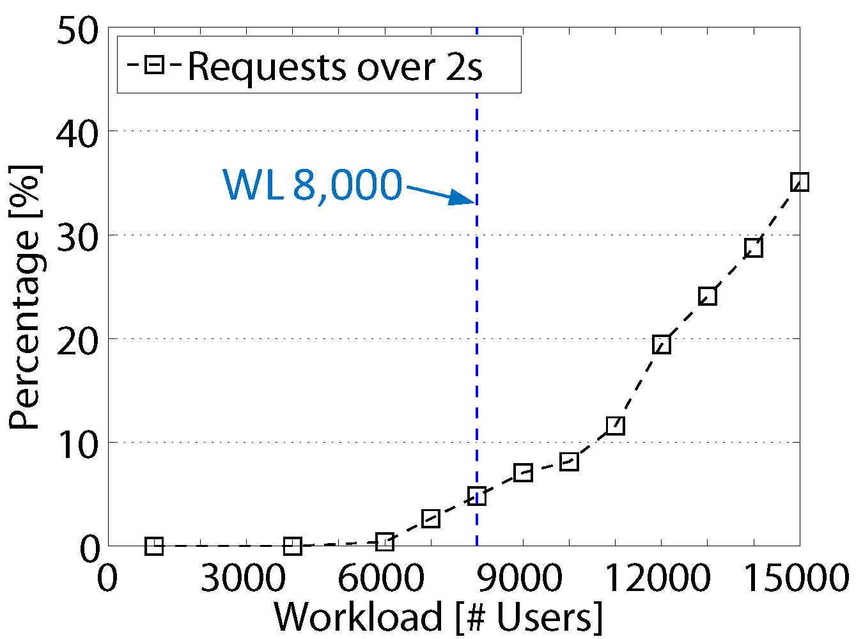
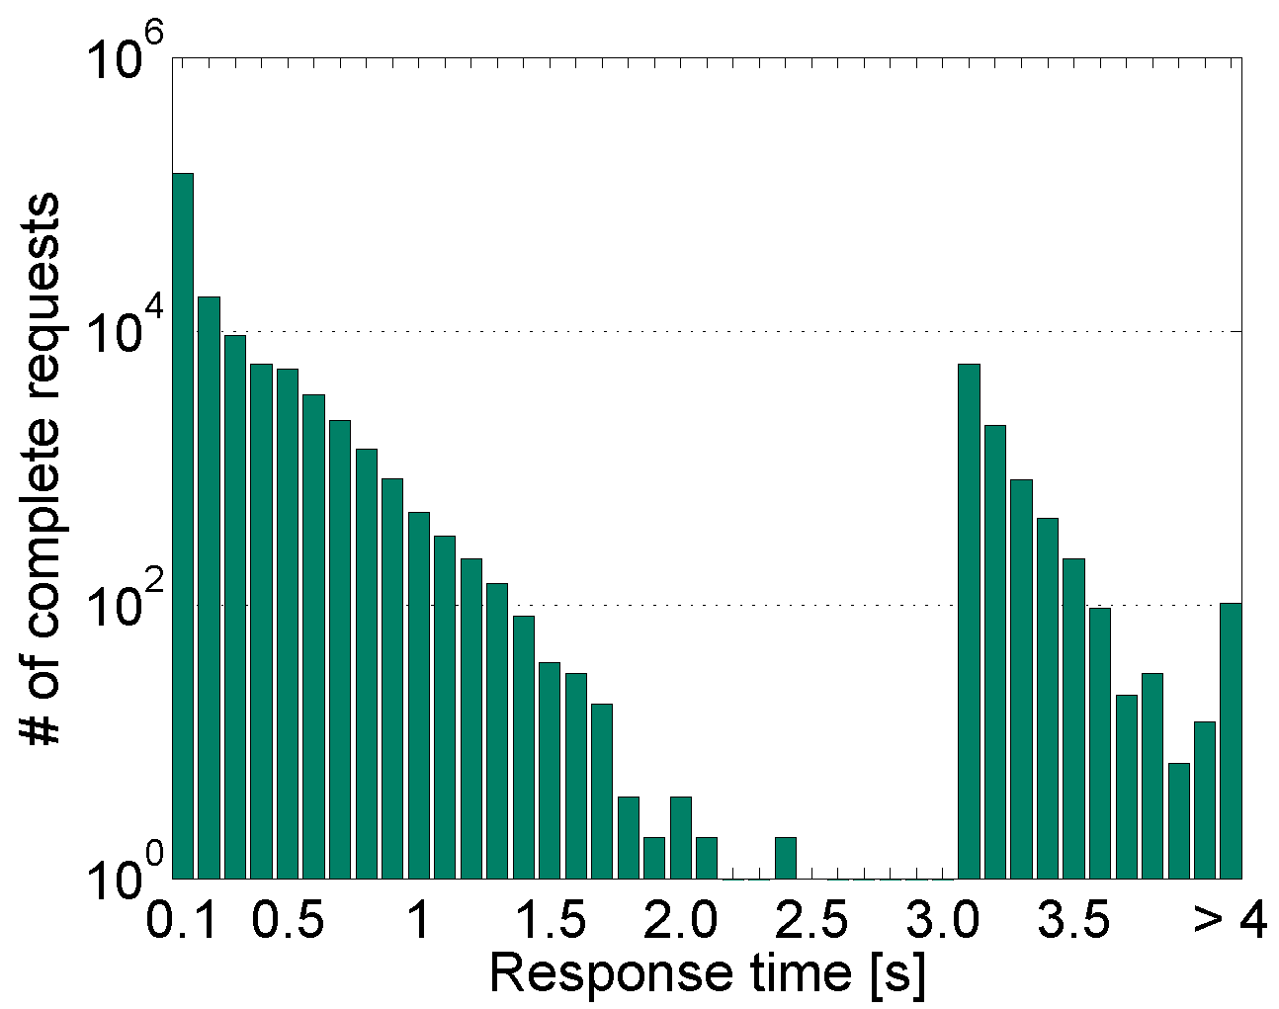
Motivational Example
Percentage of requests over two seconds
Response time distribution at workload 8,000
Notes:
1. The graph show the percentage of requests over two seconds, we can see that when the system is at workload 8,000, the number of request over two seconds is about 5%, such high percentage of long requests is considered to severely violate the SLA by most web applications.

Slide 11
Motivational Example
Average resource utilization is far from full saturation when system is at WL 8,000.
Server/Resource | CPU util. (%) | Disk I/O (%) | Network receive/send (MB/s)
Apache | 34.6 | 0.1 | 14.3/24.1
Tomcat | 79.9 | 0.0 | 3.8/6.5
CJDBC | 26.7 | 0.1 | 6.3/7.9
MySQL | 78.1 | 0.1 | 0.58/2.8
Notes:
Statistical analysis of response time distribution.
For normal distribution, using average to represent system performance make sense, but for bi-model distribution, average doesn’t make sense.

Slide 12
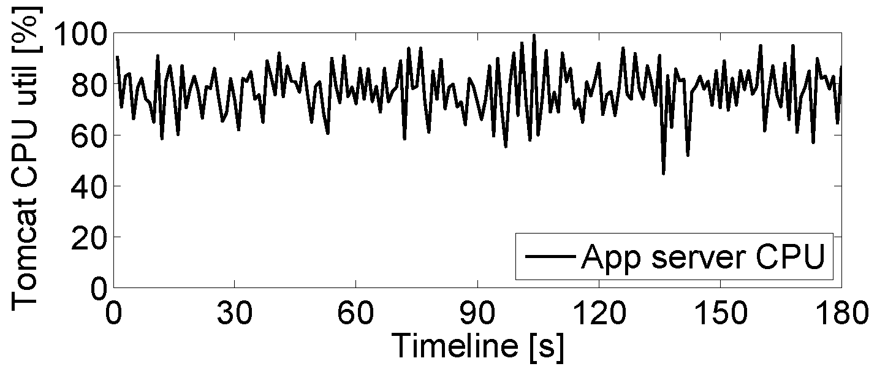
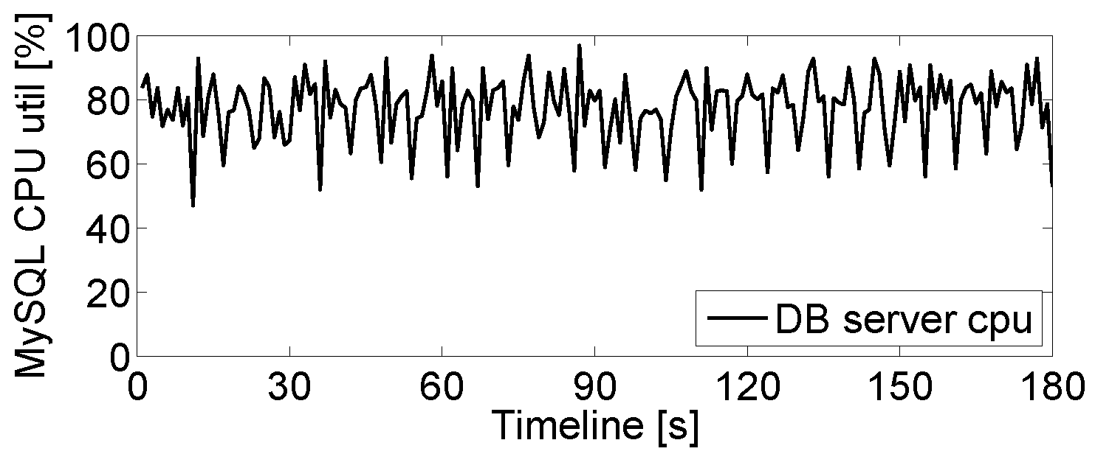
Motivational Example
Timeline graphs of Tomcat/MySQL CPU utilization (every second) at WL 8,000
Traditional monitor tools (e,g., sar) cannot detect the performance bottleneck due to their coarse granularity
Notes:
Statistical analysis of response time distribution.
For normal distribution, using average to represent system performance make sense, but for bi-model distribution, average doesn’t make sense.

Slide 13
Focus of This Research
Propose a novel transient bottleneck detection method with no or negligible monitoring overhead.
Based on passive network tracing
Detecting transient bottlenecks caused by various system factors.
Intel SpeedStep
JVM garbage collection

Slide 14
Outline
Background & Motivation
Background
Motivational experiment
Method for Detecting Transient Bottlenecks
Trace monitoring tool
Fine-grained load/throughput analysis
Two Case Studies
Intel SpeedStep
JVM garbage collection
Conclusion & Future Works

Slide 15
Our Hypothesis of Detecting Transient Bottlenecks
A bottleneck in an n-tier system is the place where requests start to congest in the system.
A transient bottleneck means the lifecycle of the bottleneck is short (e.g., millisecond level). It only causes short-term congestion in the bottleneck server.
Detecting transient bottlenecks in an n-tier system requires finding component servers that frequently present short-term congestions.

Slide 16
Trace Monitoring Tool
We use a passive network tracing tool (i.e., Fujitsu SysViz ) to reconstruct the transaction execution in an n-tier system.
Notes:
Before I start the details of the bottleneck detection method, I first introduce the monitoring tool we use.
We use a passive network tracing tool Fujitsu SysViz to trace the transaction execution in an n-tier system.
This figure shows an example of a trace of a client transaction execution in a three-tier system.
The numbered arrows show the flow of the transaction execution in the system.
Each horizontal arrow means the interaction messages between every two consecutive tier.
Each small red box means the processing of the interaction message received by a server.
SysViz is able to record the precise timestamps of the arrival and departure timestamps of each interaction message for each component server in the system.
%%%%%%%%%SysViz is able to reconstruct the entire trace of each transaction executed in the system based on the interaction messages collected through network switch.
Ths

Slide 17
Fine-Grained Load/Throughput Measurement
Given the precise arrival/departure timestamps of each request for a server, we can calculate the following two metrics of the server:
Fine-grained load
The average number of concurrent jobs in a fixed time interval (e.g., 50ms)
Fine-grained throughput
The number of complete requests in a server in the same time interval

Slide 18
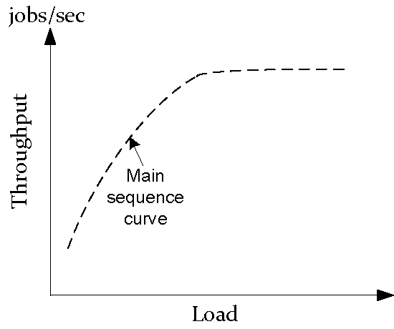
How Do We Detect Transient Bottlenecks of a Server ?
TPmax
Time window 1
Time window 2
Saturation area
Time window 3
Saturation point N*

Slide 19
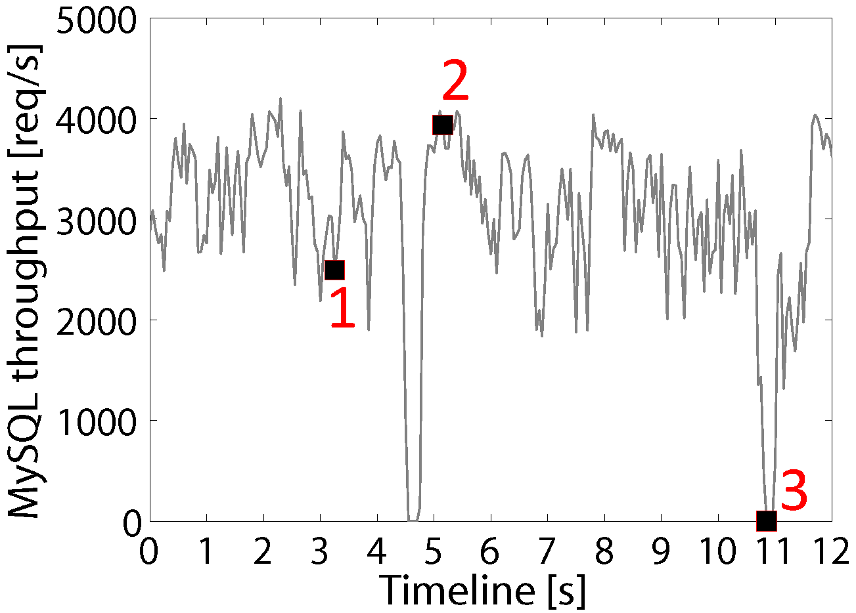
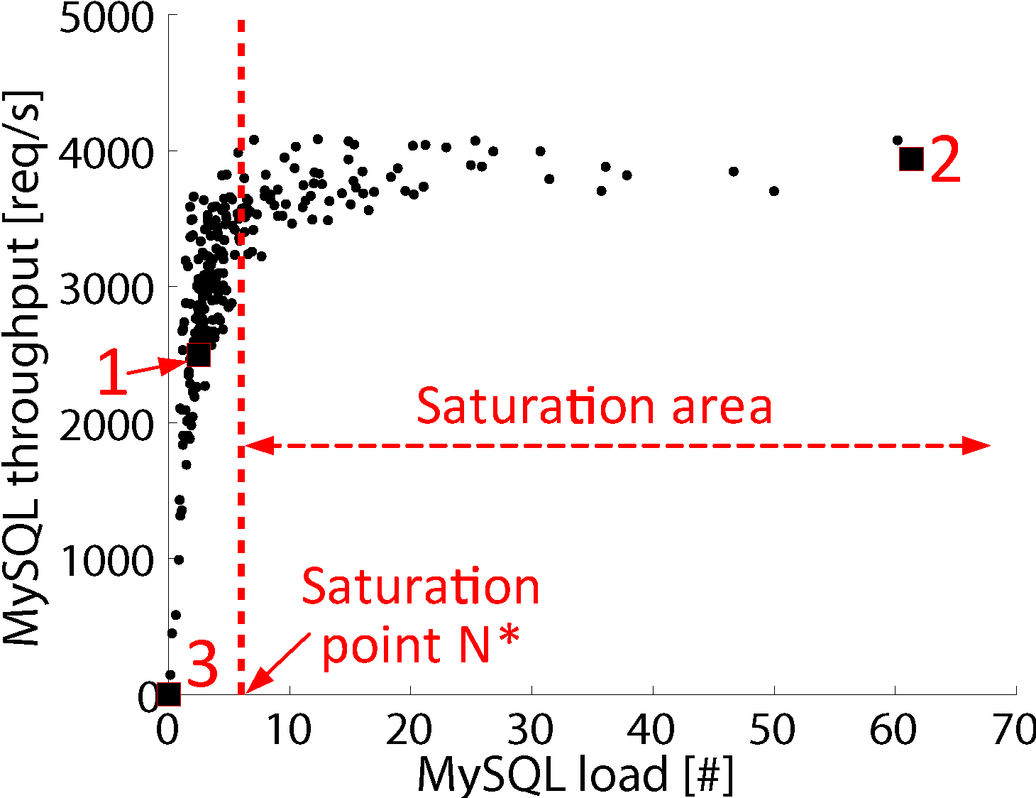
Fine-Grained Load/Throughput Analysis for MySQL at WL 7,000
Load at every 50ms
Throughput at every 50ms

Slide 20
Outline
Background & Motivation
Background
Motivational experiment
Method for Detecting Transient Bottlenecks
Trace monitoring tool
Fine-grained load/throughput analysis
Two Case Studies
Intel SpeedStep
JVM garbage collection
Conclusion & Future Works

Slide 21
Transient bottlenecks Caused by Intel SpeedStep
Intel SpeedStep is designed to adjust CPU frequency to meet instantaneous performance needs while minimizing power consumption
We found that the Dell’s BIOS-level SpeedStep control algorithm is unable to adjust the CPU frequency quick enough to match the bursty real-time workload, which causes frequent transient bottlenecks
P-state | P0 | P1 | P4 | P5 | P8
CPU Frequency [MHz] | 2261 | 2128 | 1729 | 1596 | 1197

Slide 22
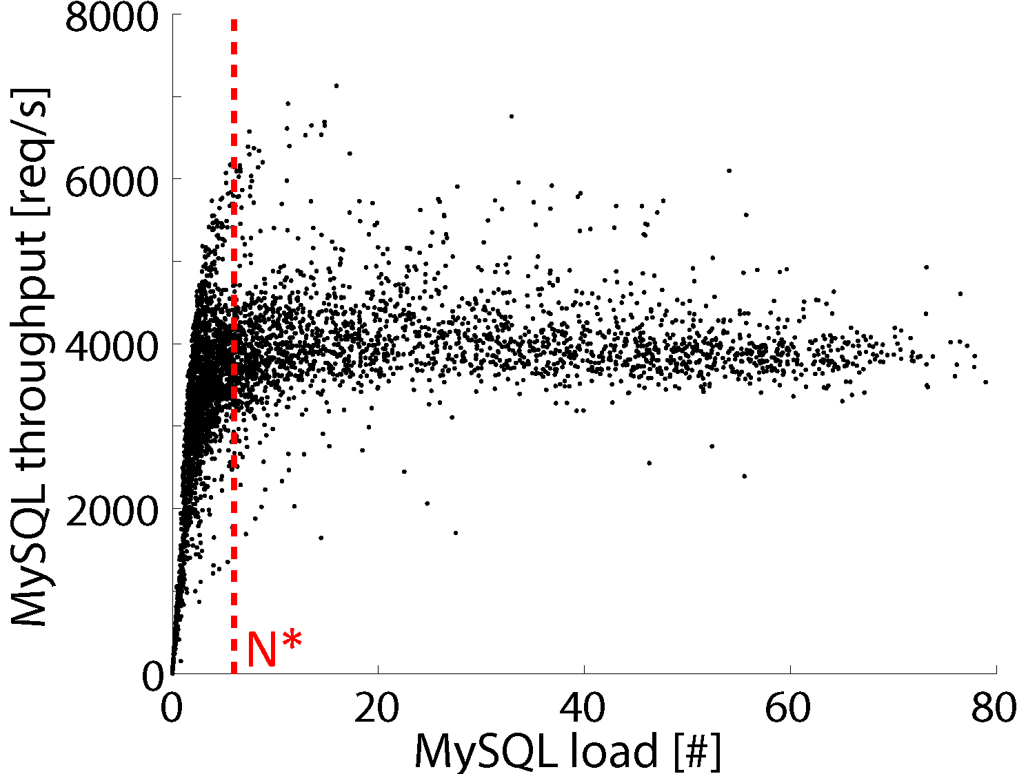
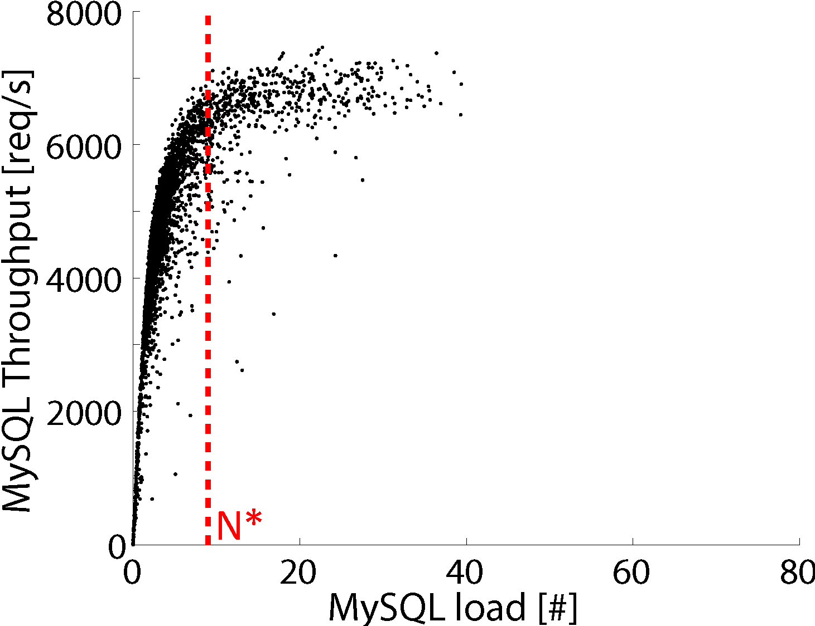
Transient bottlenecks of MySQL at Workload 8,000
SpeedStep On case
SpeedStep Off case
CPU is in high frequency
CPU is in low frequency
Notes:
1. This figure shows the fine-grained load/throughput analysis of MySQL at workload 8,000 when SpeedStep is turned on in MySQL.
2. Many points are right side of N*, which means that MySQL is transiently saturated in many time intervals.
3. The figure on the right show the fine-grained load/throughput analysis for MySQL at the same workload but the SpeedStep is turned off.
4. We can see that much less number of points are right side of N*, which means MySQL has much less short-term saturation compare to the SpeedStep On case.
5. One interesting observation is that when MySQL is transiently saturated, the throughput generated in the SpeedStep On case is around 4,000, which is roughly half of the SpeedStep Off case.
6. This is because workload 8,000 is relative low workload for MySQL, MySQL CPU prefers to stay in low frequency. Though the workload is 8,000, the fine-grained load in MySQL still naturally fluctuates. When the load in MySQL suddenly becomes high, the SpeedStep controller cannot adjust the CPU frequency to higher P-state to handle peak load, which creates transient bottlenecks.
7, In the SpeedStep Of case, since the CPU always stays in maximum frequency, the MySQL CPU is able to handle most of the peak requests, thus has much less number of transient bottlenecks compared to the SpeedStep On case.

Slide 23
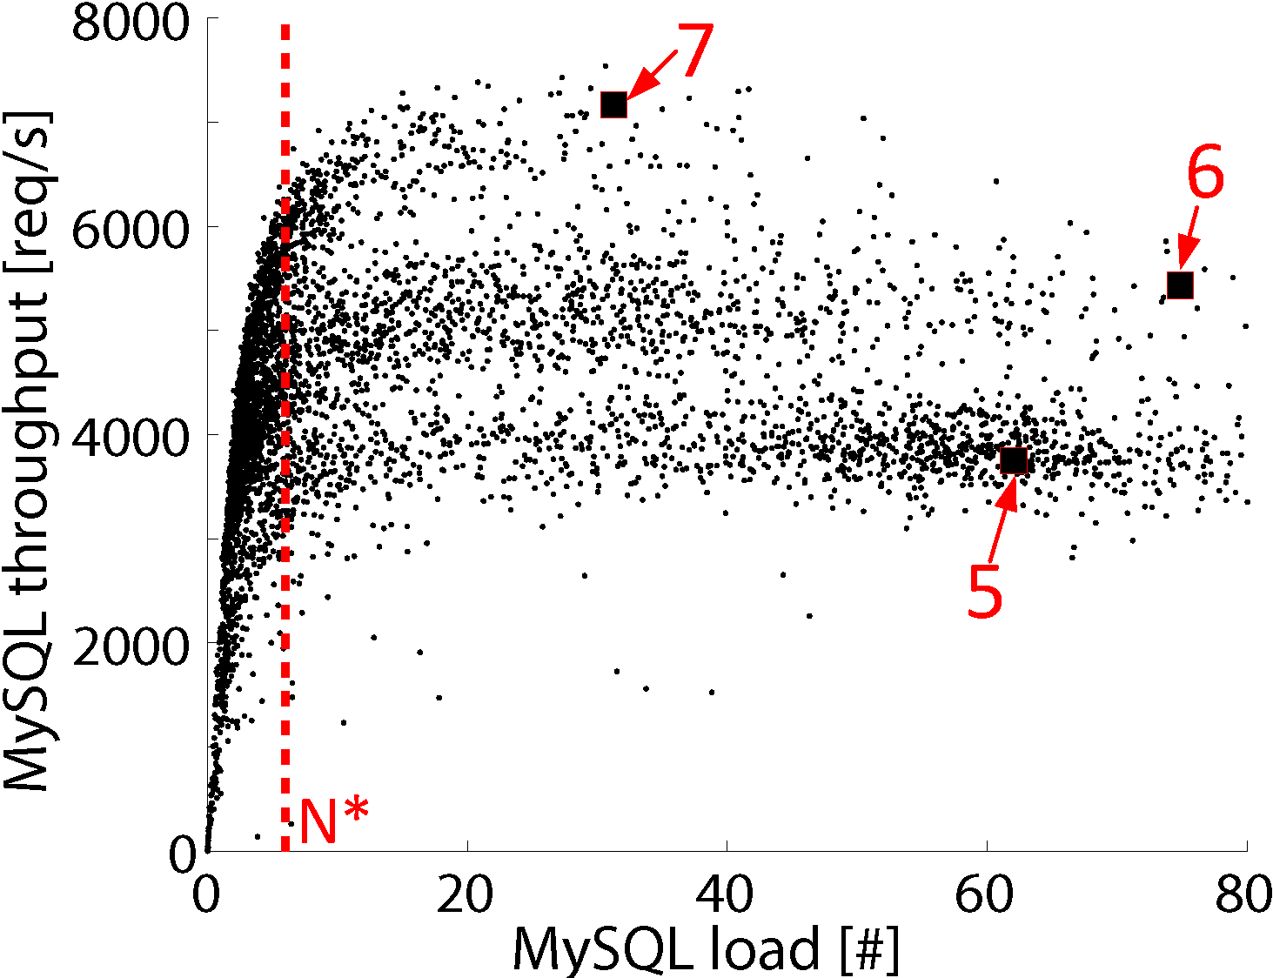
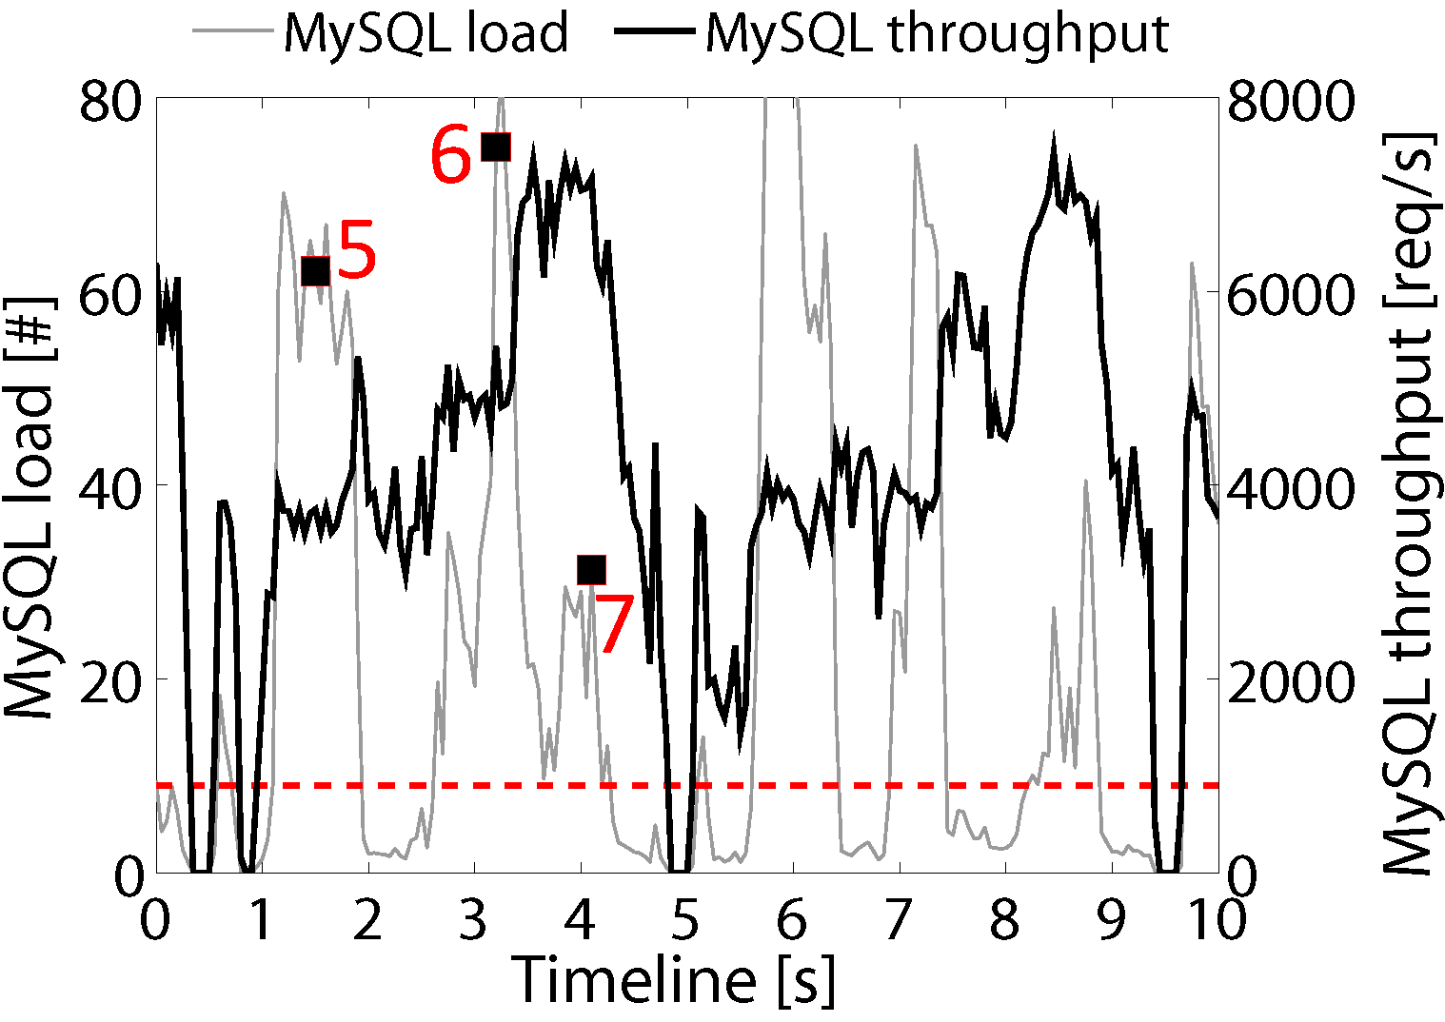
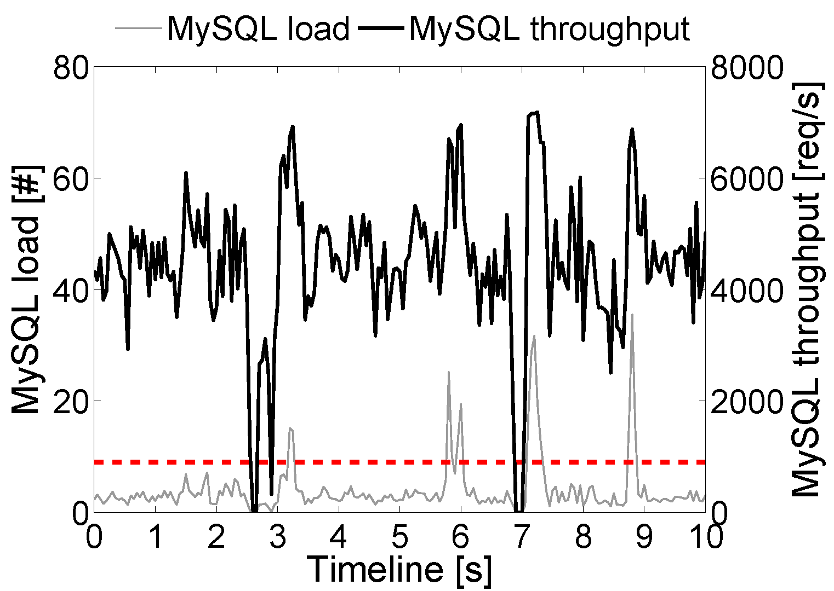
Transient bottlenecks of MySQL at Workload 10,000
SpeedStep On case
SpeedStep Off case
Notes:
Shows the transient bottlenecks of MySQL at workload 10,000
2. In the SpeedStep On case, when MySQL is transiently saturated, the throughput has clear three trends, which are represented by the highlighted points 5, 6, 7. This figure shows that MySQL CPU frequency switches among three P-states.
3. The bottom figure shows the timeline graph, the points 5, 6, 7 match back the points 5, 6, 7 in the upper figure. The grey line shows the MySQL load and the black line shows the MySQL throughput, This figure clearly shows that when MySQL is under high load. Point 5 shows when the load in MySQL is high, the generated throughput is still very low, which indicate thtat MySQL CPU frequency still stays in low frequency. This is because the CPU frequency controller doesn’t adjust CPU frequency fast enough.

Slide 24
Outline
Background & Motivation
Background
Motivational experiment
Method for Detecting Transient Bottlenecks
Trace monitoring tool
Fine-grained load/throughput analysis
Two Case Studies
Intel SpeedStep
JVM garbage collection
Conclusion & Future Works

Slide 25
Conclusion & Future Work
Transient bottlenecks in an n-tier system cause wide-range response time variations.
Transient bottlenecks may be invisible for traditional monitoring tools with coarse granularity.
We proposed a transient bottleneck detection method through fine-grained load/throughput analysis
Ongoing work: more analysis of different types of workloads and more system factors that cause transient bottlenecks.

Slide 26
Thank You. Any Questions?
Qingyang Wang
qywang@cc.gatech.edu

