Slide 1
Cura: A Cost-optimized Model for MapReduce in a Cloud
Balaji Palanisamy, Aameek Singh, Ling Liu and Bryan Langston

Slide 2
Data Growth
Worldwide Corporate Data Growth
80% of data growth:
IT.com analyses the
unstructured data
Exabytes
Source: IDC, The Digital Universe 2010
Unstructured data
Structured data

Slide 3
MapReduce in a Cloud
MapReduce and Big Data Processing
Programming model for data-intensive computing on commodity clusters
Pioneered by Google
Processes 20 PB of data per day
Scalability to large data volumes
Scan 100 TB on 1 node @ 50 MB/s = 24 days
Scan on 1000-node cluster = 35 minutes
It is estimated that, by 2015, more than half the world's data will be processed by Hadoop – Hortonworks
MapReduce Applications
At Google, Yahoo, Facebook:
Index building for Google Search, Ad optimization and Spam detection
Bioinformatics/ Biomedical
Large scale DNA Sequence analysis and Biomedical computing

Slide 4
MapReduce Execution Overview
User
Program
fork
fork
fork
Master
assign
map
assign
reduce
Input Data
map
write
Output
File 0
local
write
reduce
Split 0
read
Split 1
map
Split 2
Output
File 1
reduce
map
remote
read,
sort

Slide 5
MapReduce in a Cloud
MapReduce as a Cloud service – an attractive usage model
Enterprises can analyze large amounts of data without creating large infrastructures of their own.
Attractive features:
Elastic Scalability: 100s of nodes available in minutes
Pay per-use
On demand creation of virtual MapReduce clusters of any required size
Existing Dedicated MapReduce Clouds
Natural extensions of Virtual Machines as a service model
Performance and cost-inefficiency

Slide 6
Need for Cost-optimized Cloud Usage Model
Existing Per-job Optimized Models:
Per-job customer-side greedy optimization may not be globally optimal
Higher cost for customers
Cura Usage Model:
User submits job and specifies the required service quality in terms of job response time and is charged only for that service quality
Cloud provider manages the resources to ensure each job’s service requirements
Other Cloud Managed Resource models:
Database as a Service Model
Eg: Relational Cloud (CIDR 2011)
Cloud managed model for Resource management
Cloud managed SQL like query service
Delayed query model in Google Big Query execution results in 40% lower cost

Slide 7
User Scheduling Vs Cloud Scheduling
Job# | Arrival time | Deadline | Running time | Optimal no. Of VMs
1 | 20 | 40 | 20 | 20
2 | 25 | 50 | 20 | 20
3 | 30 | 75 | 20 | 20
4 | 35 | 85 | 20 | 20
User Scheduling
Job # | 1 | 2 | 3 | 4
Start time | 20 | 25 | 30 | 35
80 concurrent VMs
Cloud Scheduling
Job # | 1 | 2 | 3 | 4
Start time | 20 | 25 | 40 | 45
40 concurrent VMs

Slide 8
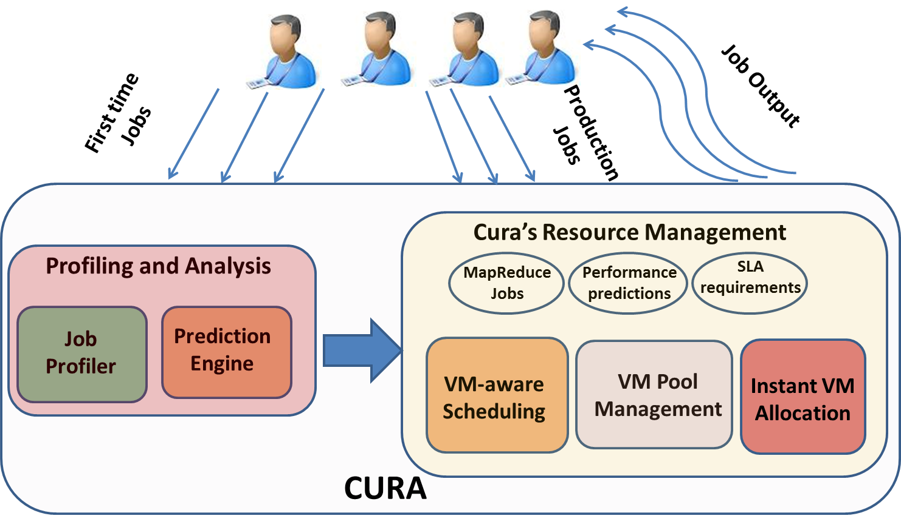
Cura System Architecture

Slide 9
Static Virtual Machine sets
Pool of Large instances
Cluster of physical machines
Pool of small instances
Pool of extra large instances

Slide 10
Static Partitioning of Virtual Machine sets
Pool of Large instances
Cluster of physical machines
Pool of small instances
Pool of extra large instances

Slide 11
Problem Statements
Resource Provisioning and Scheduling
Optimal scheduling
Optimal Cluster Configuration
Optimal Hadoop Configuration
Virtual Machine Management
Optimal capacity planning
Right set of VMs(VM types) for current workload?
Minimize Capital expenditure and Operational expenses
Resource Pricing
What is the price of each job based on its service quality and job characteristics?

Slide 12
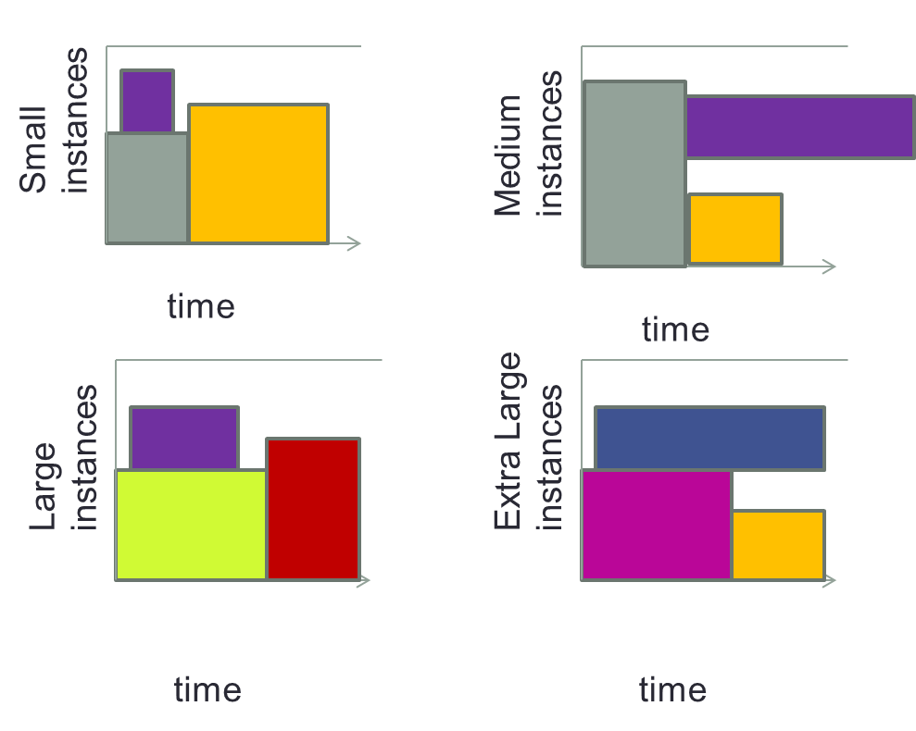
VM-aware Job Scheduling
Multi-bin backfilling
Scheduler needs to decide on which instance type to use for the jobs
The job scheduler has two major goals:
(i) complete all job execution within the deadlines
(ii) minimize operating expense by minimizing resource usage

Slide 13
VM-aware Scheduling Algorithm
Goal:
VM-aware scheduler decides (a) when to schedule each job in the job queue, (b) which VM instance pool to use and (c) how many VMs to use for the jobs.
Minimum reservations without under-utilizing any resources.
Job J_{i} has higher priority over Job J_{j} if the cost of scheduling J_{i} is higher.
For each VM pool picks the highest priority job, J_{prior} in the job queue and makes a reservation.
Subsequently, the scheduler picks the next highest priority jobs in the job queue by considering priority only with respect to the reservations that are possible within the current reservation time windows of the VM pools.
Runs in O(n²) time
Straight forward to obtain a distributed implementation to scale further

Slide 14
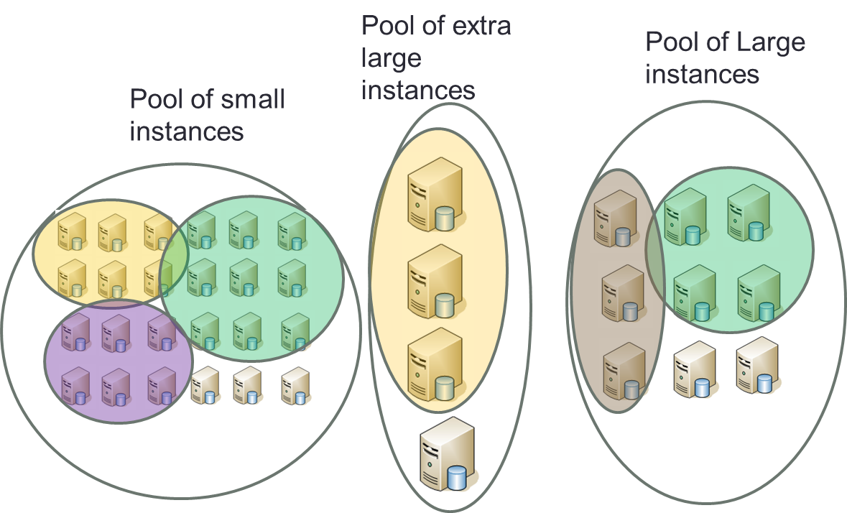
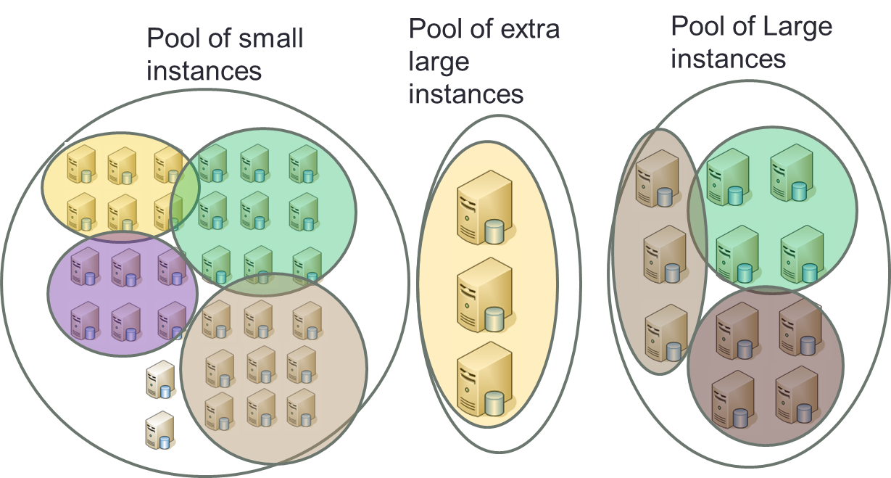
Reconfiguration-aware Scheduler
When two new jobs need a cluster of 9 small instances and 4 large instances respectively, the scheduler has the following options:
Wait for some other clusters of small instances to complete execution
Run the job in a cluster available of extra large instances
Convert some large or extra large instances into multiple small instances
Reconfiguration-unaware Scheduler
Reconfiguration-aware Scheduler

Slide 15
Number of servers and Effective Utilization
Fig 5. No. of Servers
Fig 6. Effective Utilization
Cura requires 80% lower resources than conventional cloud models
Cura achieves significantly higher resource utilization

Slide 16
Response time and Cost
Fig 7. Response time
Fig 8. Cost
With lower number of servers, Cura provides short response times
Cura incurs much lower infrastructure cost

Slide 17
More results in our IPDPS 2013 paper:
B. Palanisamy, A. Singh, L. Liu and B. Langston, “Cura: A Cost-optimized Model for MapReduce in a Cloud”, IPDPS 2013
Thank you & Questions

