Slide 1
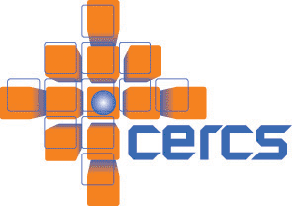

System for Troubleshooting Big Data Applications in Large Scale Data Centers
Chengwei Wang
Advisor: Karsten Schwan
CERCS Lab, Georgia Institute of Technology

Slide 2
Collaborators
Canturk Isci (IBM Research)
Vanish Talwar, Krishna Viswanathan, Lakshminarayan Choudur, Parthasarathy Ranganathan, Greg MacDonald, Wade Satterfield, (HP Labs)
Mohamed Mansour (Amazon.com)
Dani Ryan (Riot Games)
Greg Eisenhauer, Matthew Wolf, Chad Huneycutt, Liting Hu (CERCS, Georgia Tech)

Slide 3
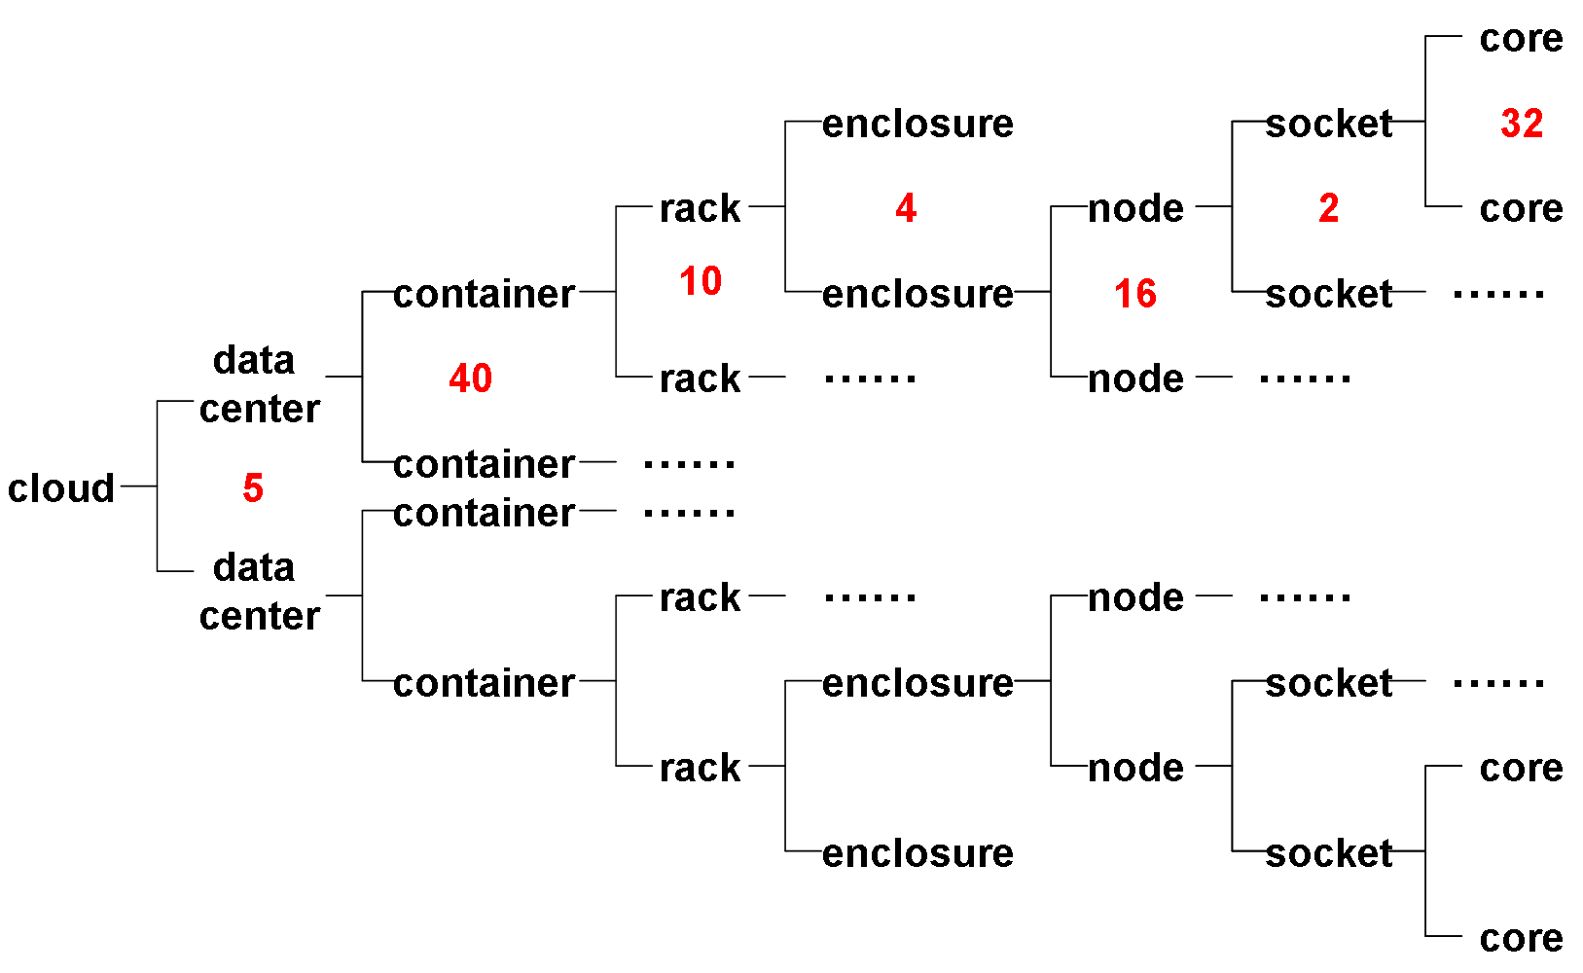
Large Scale Data Center Hardware
Routers, Switches, Network Topologies ….
5 x 40 x 10 x 4 x 16 x 2 x 32 = 8’192’000 cores (8 million + VMs)
Amazon EC2 has estimated 454,400 (~0.5 million) Servers.

Slide 4

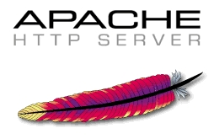







Large Scale Data Center Software
Web
APP
Big
Data
Stream
Data
Twitter Storm

Slide 5


‘Big Data’ Application
(PageID, # views)
Data Blocks
Page Views
Exposed as Services in Utility Cloud

Slide 6

Troubleshooting War On Christmas Eve
Based 2010 quarterly revenues, downtime could cost up to $1.75 million/hour
Not a perfect Christmas ……
Amazon ELB state data accidentally deleted
Netflix Streaming Outage
Amazon engineers find the root cause
Recover ELB state data to state before it is deleted
Data state merge process completed
War is over,
well,
forever?
12:24 PM
12:30 PM
17:02 PM
2:45 AM
12/25/2012
5:40 AM
12/25/2012
8:15 AM
12/25/2012
Local Issue
API partially affected
A large number of ELB services need to be recovered
Global Issue
ELB Requests High Latency
Notes:
API affected?

Slide 7
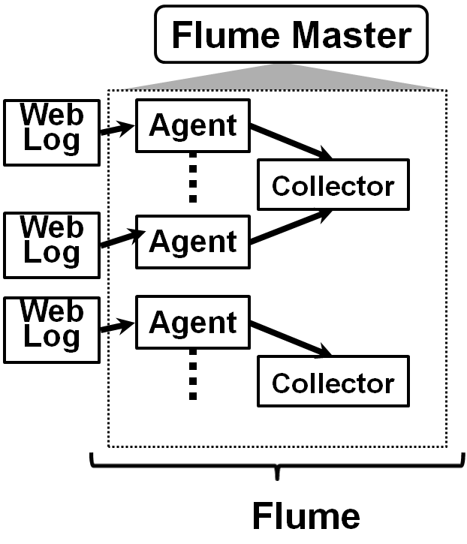
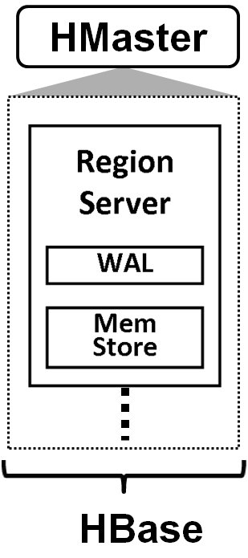
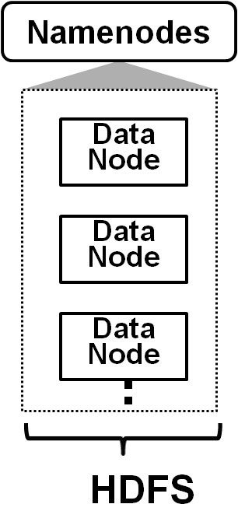
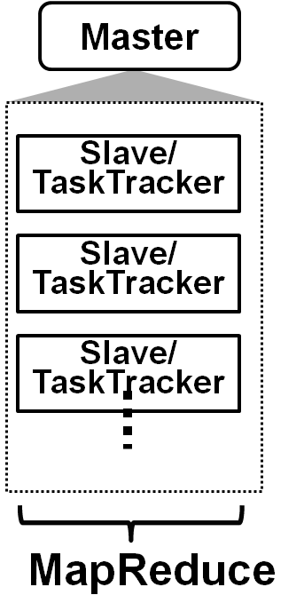
Challenges for Troubleshooting
E2E Latency
?
?
?
Large Scale : thousands to millions entities
Dynamism : dynamic interactions/dependencies
Overhead : profiling/tracing information required
Time-Sensitive : responsive troubleshooting online
Notes:
Automation is totally possible. Because of the primitiveness of the operations.
Key question how to do online tracing and debugging?

Slide 8
Research Components
Modeling Monitoring/Analytics System Design²
Statistical Anomaly Detection: EbAT, Tukey, Goodness-of-Fit^{3,4}
Anomaly
Ranking⁵
Guidance
VScope: Middleware for Troubleshooting Big Data APPs¹
VScope: Middleware for Troubleshooting Time-Sensitive Data Center Applications, Middleware’12.
A Flexible Architecture Integrating Monitoring and Analytics for Managing Large-Scale Data Centers, ICAC’11
Statistical Techniques for Online Anomaly Detection in Data Centers, IM’11
Online Detection of Utility Cloud Anomalies Using Metric Distribution, NOMS’10
Ranking Anomalies in Data Centers, NOMS’12

Slide 9
Research Components
Modeling Monitoring/Analytics System Design
Statistical Anomaly Detection: EbAT, Tukey, Goodness-of-Fit
Anomaly
Ranking
Guidance
VScope: Middleware for Troubleshooting Big Data APPs

Slide 10
What is VScope?
From systems perspective, VScope is a distributed system for monitoring and analyzing metrics in data centers.
From user’s perspective, VScope is a tool providing dynamic mechanisms and basic operations to facilitate troubleshooting.

Slide 11
Human Troubleshooting Activities
Anomaly Detection
Interaction Analysis
Profiling & Tracing
Monitoring agent latency, Alarm when latency high
Which collector did the problematic agent talk to?
RPC-log in regionservers
Debug-log in data nodes
Which agents had the abnormal latencies?
Which regionservers did the collector talk to?
Notes:
It paves the way for automation. This level of abstraction we think it is good for automation. Clearly identify the non divisible units for troubleshooting, and make it possible to automate the procedure.

Slide 12
VScope Operations
Anomaly Detection
Interaction Analysis
Profiling & Tracing
Watch
Scope
Query
Dynamic metric collection/analytics deployment
Continuous anomaly detection
On-line interaction tracking
Notes:
Must mention for dependency analysis, there can be a lot of ways to do it Orion, vPath, Project5 from HP, Sherlock they all can be integrated into Scope operation for dependency analysis.

Slide 13
Distributed Processing Graph (DPG)
Global Results
VNode
Metrics
Look-Back
Window
Local Analysis Results
Local Analysis Results
Flexible
Topology
VNode
VNode
Aggregate Monitoring Data
Metrics
Metrics
Metrics

Slide 14
VScope System Architecture
VScope/DPG Operations
VShell
function
metric
library
library
VMaster
DPGManager
DPGManager
DPG
DPG
DPG
Initiate, Change, Terminate
VNode
Dom0
DomU
DomU
agent
Flume master
collector
Xen Hypervisor
Notes:
Delete Hbase!

Slide 15
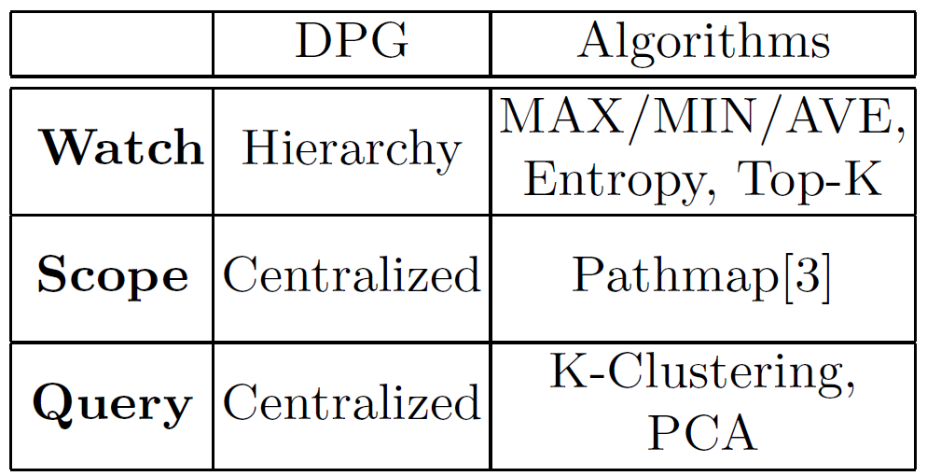
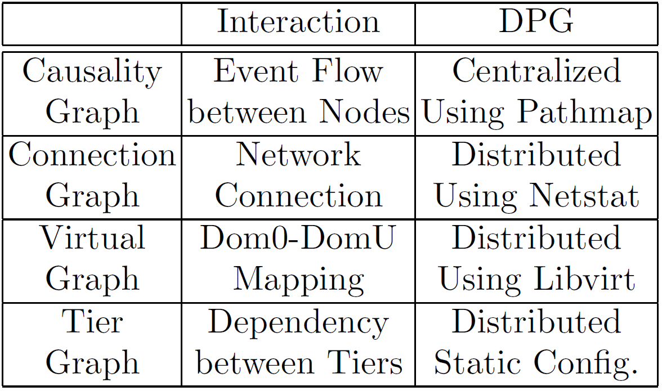
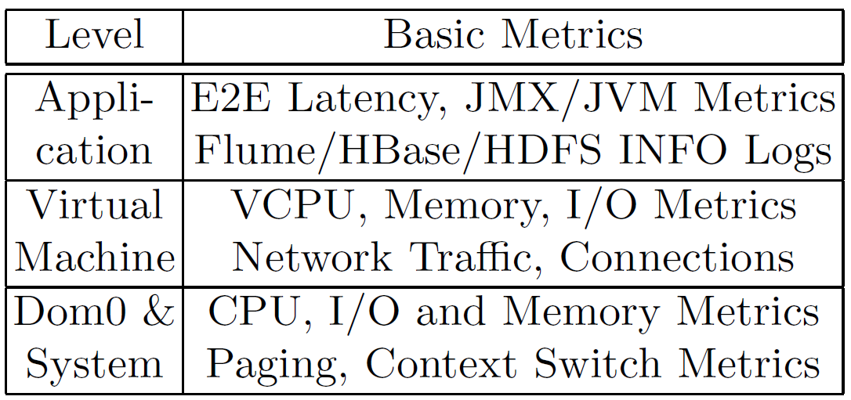
VScope Software Stack
Troubleshooting Layer
Watch
Scope
Query
Guidance
Anomaly Detection & Interaction Tracking DPGs
API&
Cmds
DPG Layer
VScope Runtime
Notes:
Vscope supports not ‘we have’, tier graph explanation.

Slide 16
Usecase I: Culprit Region Servers
Normal
Slow? Which?
E2E Perf.
Low
Inter-Tier Issue: When you see E2E Performance is slow, was it due to collector or region server issues?
Scale: There could be thousands of region servers!
Interference: High interference when turning on debug-level java logging.
Notes:
Complexity of multi-tier, dependency – horizontal scope

Slide 17
Horizontal Guidance (Across Tiers)
iterative analysis
E2E Latency
Entropy Detection
Using Connection Graph
Analyzing Timing in RPC-level logs
Flume
Agents
Watch
Scope
Query
Abnormal Flume Agents
Shared RegionServers
Processing Time in RegionServers
SLA Violation on Latency
Related Collectors&
Region Servers
Dynamically Turn on Debugging

Slide 18
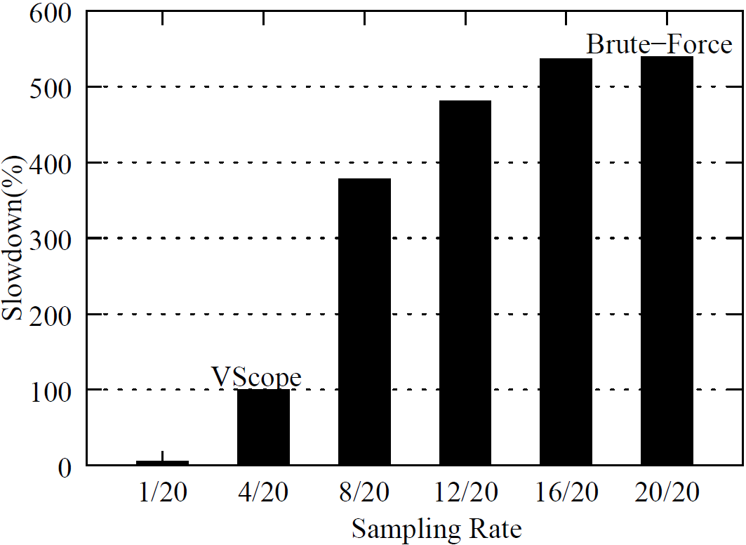
VScope vs Traditional Solutions
20 Region Servers, One Culprit Server
VScope has highly reduced interference to application.

Slide 19
Usecase II: Naughty VM
Slow
Over-consume
Shared Resource
(Due to heavy HDFS I/O)
Agent
Slave/ TaskTracker
Good VM
Naughty VM
Hypervisor
Inter-Software-Level Issue: it is hard to find the root cause without knowing VM-Machine mapping.

Slide 20
Vertical Guidance (Across SW Levels)
Watch
E2E Latency
Query
Good VM
Scope/Query
Hypervisor
Scope/Query Naughty VM
HDFS I/O
Remedy
Notes:
Locate not localize, 要从现象到本质， 先看到第一个，再看到第二个。

Slide 21
VScope Performance Evaluation
What’re the monitoring overheads?
How fast can VScope deploy a DPG?
How fast can VScope track interactions?
How well can VScope support analytics functions?

Slide 22
Evaluation Setup
Deployed VScope on CERCS Cloud (using OpenStack) hosting 1200 Xen Virtual Machines (VMs).
http://cloud.cercs.gatech.edu/
Each VM has 2GB memory and at least 10G disk space.
Ubuntu Linux Servers (1TB SATA disk, 48GB Memory, and 16 CPUs (2.40GHz).
Cluster with 1 GB Ethernet networks.

Slide 23
GTStream Benchmark
(PageID, # views)
Data Blocks
Page Views

Slide 24
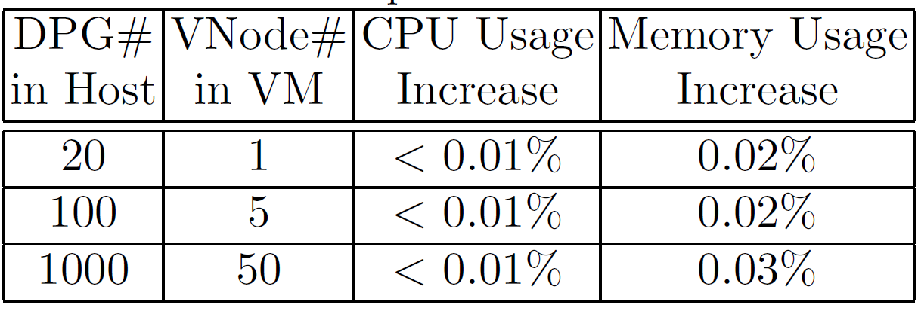
VScope Runtime Overheads
DPGs are doing anomaly detection and interaction tracking
VScope has low overheads.

Slide 25
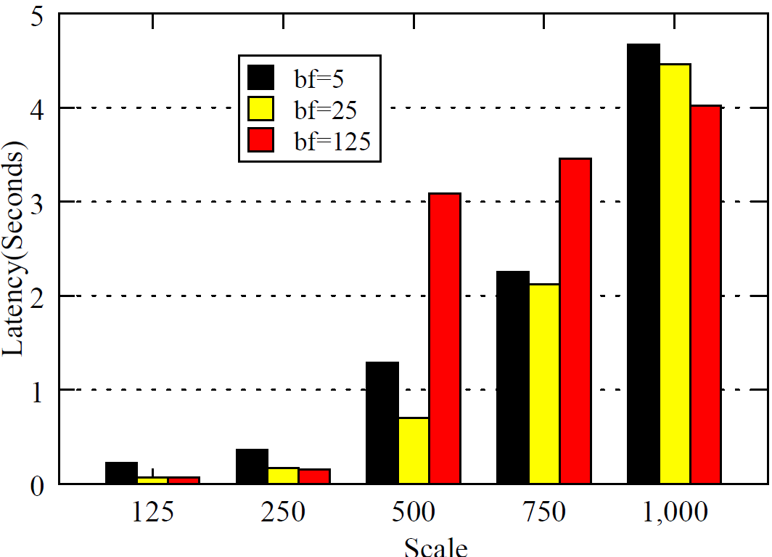
DPG Deployment
Deploy balanced-tree DPG on VMs with different BFs (Branching Factor)
# of vms
Fast DPG deployment at large scale with various topologies

Slide 26
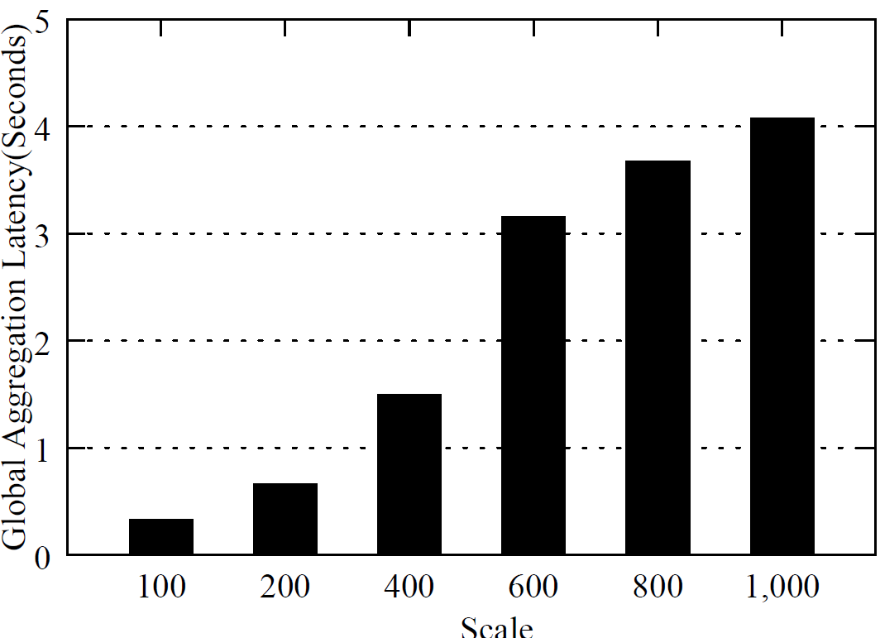
Interaction Tracking
Tracking network connection relations between VMs
# of vms
Fast interaction tracking at large scale
Notes:
Talking about this is the worst case scenario, It is the intensive tracking.

Slide 27
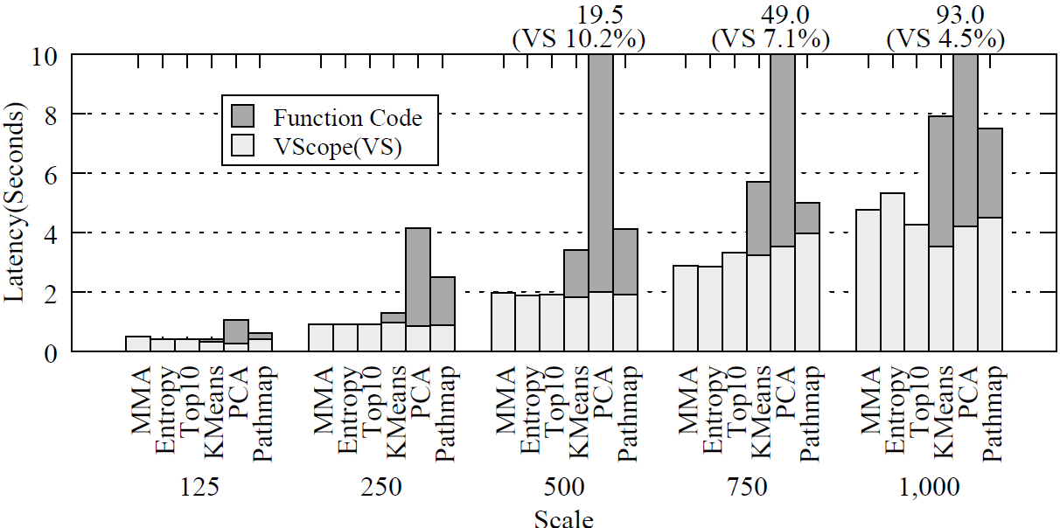
Analytics Support
Measuring deployment & computation time on with real analytics
Efficiently support a variety of analytics.
Notes:
With only talking about the Vscope is only bounded by 4 seconds, it is never the bottle neck.

Slide 28
VScope Features
 | Debug-Level On-Line Troubleshooting |  |  |  | Info-Level On-Line Monitoring
 | Low Storage | Low Network | Low Interference | Complete Coverage | Low Storage | Low Network | Low Interference | Complete Coverage
Brute-Force: Ganglia, Nagios, Astrolabe, SDIMS |  |  |  | √ | √ | √ | √ | √
Sampling: GWP, Dapper, Fay, Chopstix | √ | √ | Uncontroll-able | Random | √ | √ | √ | Random
VScope | √ | √ | Controllable | Focused | √ | √ | √ | Focused
VScope Advantages:
Controllable Interference
Guided/Focused Troubleshooting

Slide 29
Research Components
Modeling Monitoring/Analytics System Design
Statistical Anomaly Detection: EbAT, Tukey, Goodness-of-Fit
Anomaly
Ranking
Guidance
VScope: Middleware for Troubleshooting Big Data APPs

Slide 30
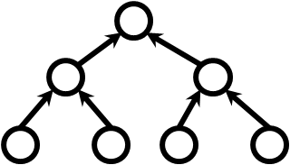
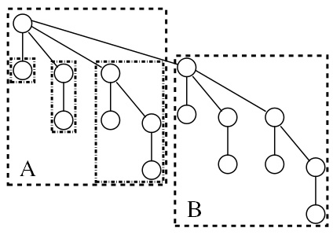
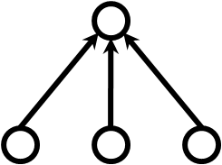
Monitoring/Analysis System Design Choices
Traditional Design
Novel System Design (Using DPG)
> Hybrid: Federating Various Topologies
> Dynamic: Topologies On-Demand
Centralized
Balanced Tree
Binomial Tree
Notes:
Draw those topologies. 画几个图

Slide 31
Modeling Monitoring/Analysis System Performance/Cost
Is there the best design choice in for all scales?
How does scale affect system design?
How do analytics features affect system design?
How do data center configs. affect system design?
Is there any tradeoff between performance/cost?

Slide 32
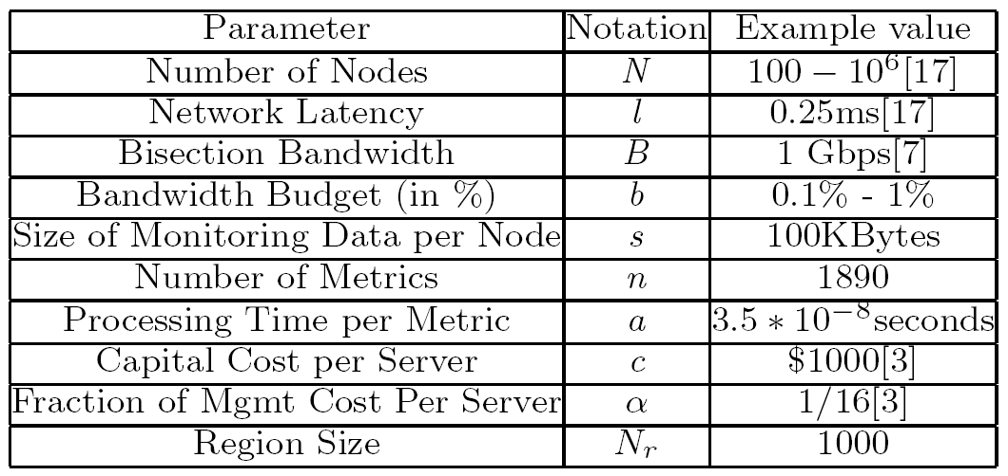
Data Center Parameters
*Example values are quoted from publications or gained from micro-benchmark experiments and experiences of HP production teams

Slide 33
Performance/Cost Metrics
Performance: Time to Insight (TTI)
The latency between the time when (a) monitoring metric(s) is(are) collected and the time when the analysis of the metric(s) is done.
Cost: Capital Cost for Management
Dollar amount spent on hardware/software for monitoring/analytics.

Slide 34









Analytical Formulations
 | Time To Insight (TTI) | Capital Cost
Centralized
Hierarchical Tree
Binomial Forest
Hybrid Topologies

Slide 35
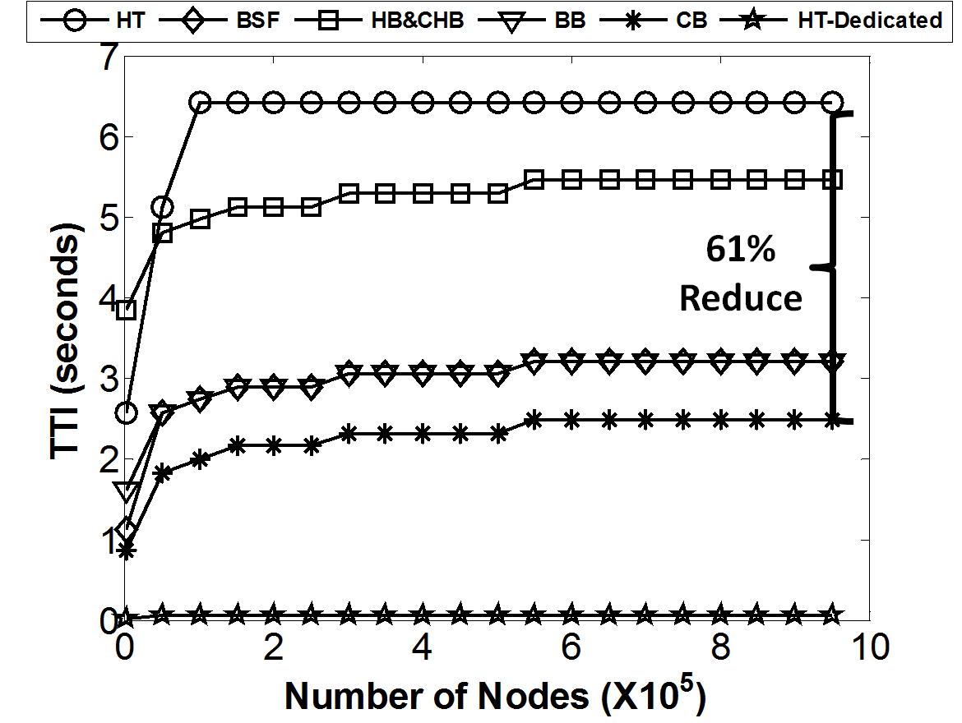
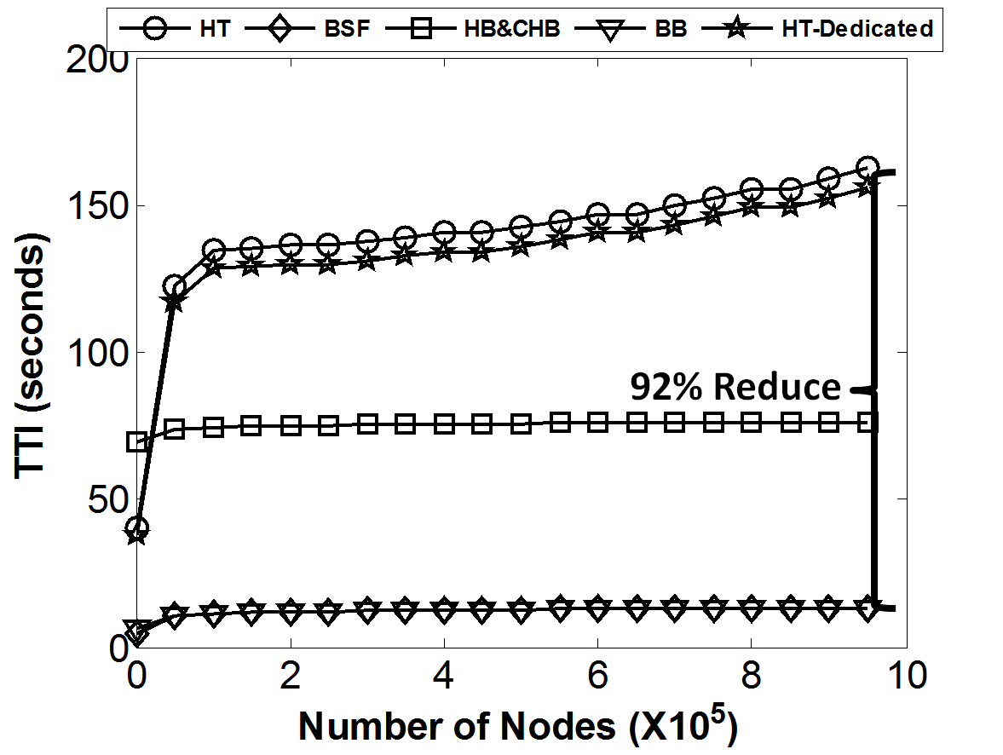
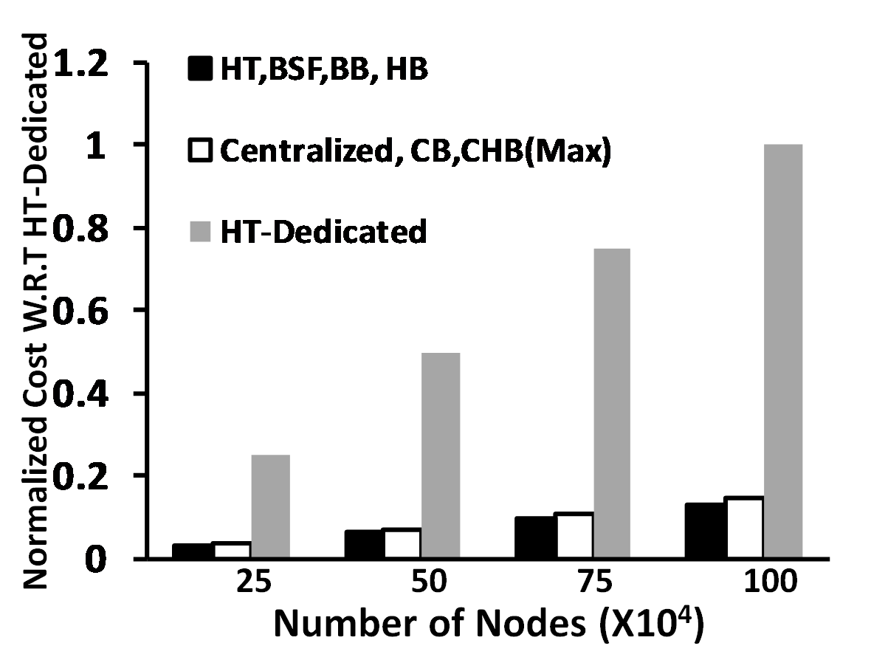
Compare Topologies at Scale
Analytics O(N) Complexity
Analytics O(N²) Complexity
Capital Cost
No one is the best in all configurations
High performance may incur high cost
Hybrid design may be a good choice
Notes:
不要说may, 说is, 不然不确定

Slide 36
Trade-off of Performance/Cost
Lowest TTI
Highest Cost
Hierarchical Tree (fanout 2) has best performance but has highest cost
Centralized has best performance and lowest cost when <2000 nodes, but worst performance when >6000
Best

Slide 37
Insights
No static, ‘one size fits all’, topology
Design may tradeoff performance/cost
DPG can provide dynamic topology and analytics variety support at large scale
Novel, hybrid topology can yield good performance/cost.
The principles we follow in VScope.

Slide 38
Research Components
Modeling Monitoring/Analytics System Design
Statistical Anomaly Detection: EbAT, Tukey, Goodness-of-Fit
Anomaly
Ranking
Guidance
VScope: Middleware for Troubleshooting Big Data APPs

Slide 39
Statistical Anomaly Detection
Distribution-based anomaly detection
Online
Integrated into VScope
Dynamically deployed by VScope

Slide 40
A Brief Summary
Entropy-based Anomaly Tester (EbAT)
Leveraging Tukey Method and Chi-Square Test
Experiment on Real-World Data Center Traces

Slide 41
Conclusion
VScope is a scalable, dynamic, lightweight middleware for troubleshooting real-time big data applications.
We validate VScope in large-scale cloud environment with a realistic multi-tier stream processing benchmark.
We showcase VScope’s abilities of troubleshooting horizontally across-tiers and vertically across-software-levels in two real-world use cases.
Through analytical modeling, we concludes that dynamism, flexibility, and tradeoff between performance and cost are needed for large scale monitoring/analytics system design.
We proposed statistical anomaly detection algorithms based on distribution change rather than change in individual measurements

Slide 42
State of the Art: System Analytics
Scale
Ph.D. Thesis
Research Area
Cloud
Moara
Data Center
Ganglia
SIAT
Hyp. HQ
Console mining
Chukwa
Cluster
G.work
Openview/Tivoli
Dynamic
Osmius
PMP
sherlock
CLUE
Multi-Tier
pinpoint
Single host
sar
ps
regression
Dapper
slick
magpie
Fay
Static
vmstat
top
GWP
Chopstix
Dynamism
Complexity/Online
Lack systems and algorithms to support dynamic, online, complex diagnosis at large scale

Slide 43
Future Work
System Analytics
Large scale complexities, a variety of workloads, big data (system logs, application traces)
Cloud Management (resource management, troubleshooting, migration planning, performance/cost analysis); Power Management; Performance optimization, etc.
Investigating/Leveraging large scale, online, machine learning and data mining for system analytics

Slide 44
Thanks!
Questions?
Notes:
Chart

Slide 45
Backup Slides

Slide 46
VScope System Architecture
VScope/DPG Operations
VShell
Query
function
metric
library
library
OpenTSDB
VMaster
DPGManager
DPGManager
DPG
DPG
DPG
Initiate, Change, Terminate
Historical
Data
VNode
TSD
TSD
Time-Series Daemon
Dom0
DomU
DomU
agent
Flume master
collector
Xen Hypervisor
Notes:
Delete Hbase!

Slide 47
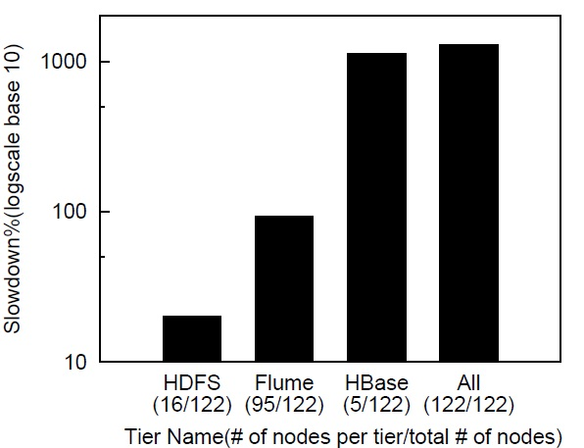
Why Dynamism is Important?
We cannot afford tracing everywhere!

Slide 48
Distribution-based vs Value-based
Sporadic Spikes
Pattern vs individual measurement

Slide 49
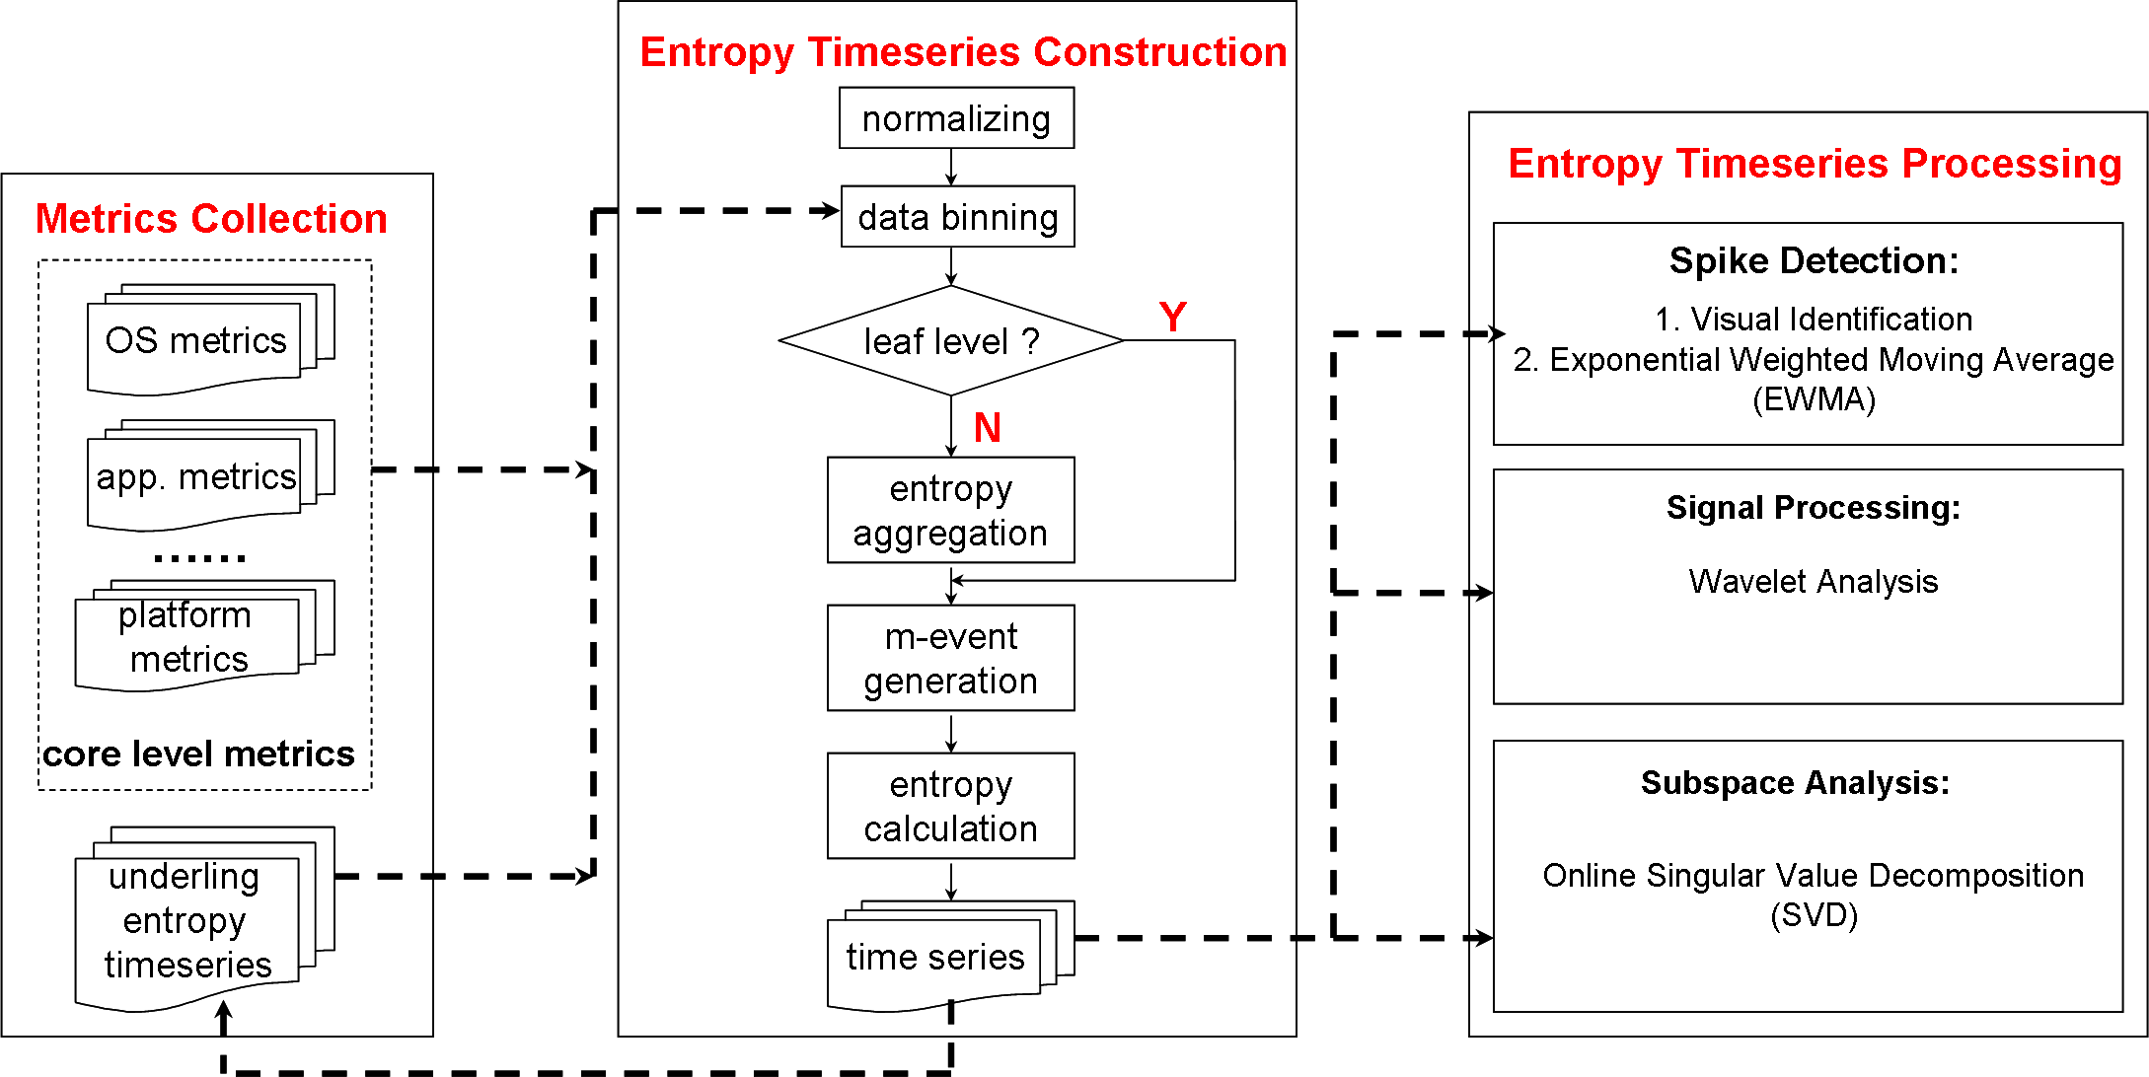
EbAT (Entropy-based Anomaly Tester)
Threshold-based
1. Visual Identification
2. Three-Sigma Rule
Signal Processing
1. Wavelet Analysis
Time Series Analysis
1. Exponential Weighted Moving Average (EWMA)

Slide 50
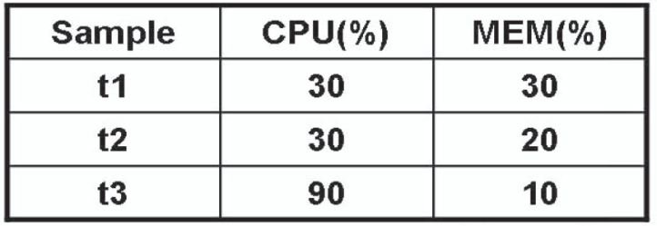
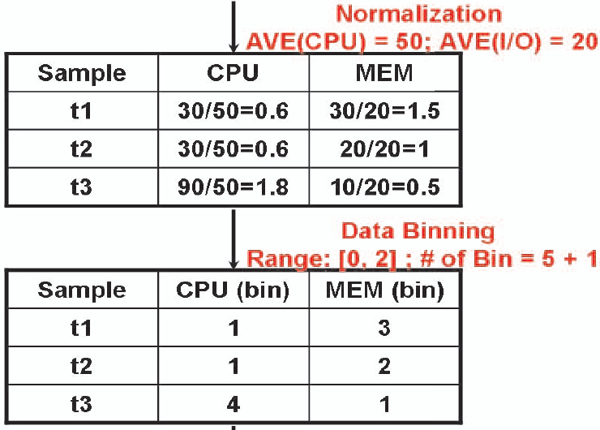
Entropy Time Series Construction
1. Maintain look back window
Example
Look-back
window of
Size 3
Look back windows
2. Perform data pre-processing
  Normalization: divide values
  by mean of samples
  Data binning: hash values into a bin of size m+1

Slide 51
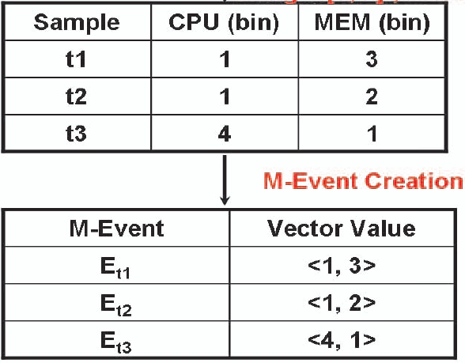


Entropy Time Series Construction
3. M-Event Creation for look-back window
Monitoring Event (M-Event)@sample s
<e_{s1}, e_{s2}, e_{s3}, …., e_{sn}>
4. Entropy Calculation
  Determine count of each event e_{i} in the n samples (n_{i})
  Given v unique events e_{i} in the n samples, entropy is calculated as

Slide 52
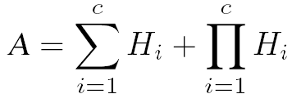
Local and Global Entropies
Entropy timeseries is created at every level of the cloud hierarchy
Local entropy: Leaf level entropy timeseries (at every VM)
  uses raw monitoring data as input
Global entropy: Non-leaf level entropy timeseries (aggregated entropy)
  uses child entropy timeseries as input data
  can calculate entropy of child entropies or aggregate it in other ways

Slide 53
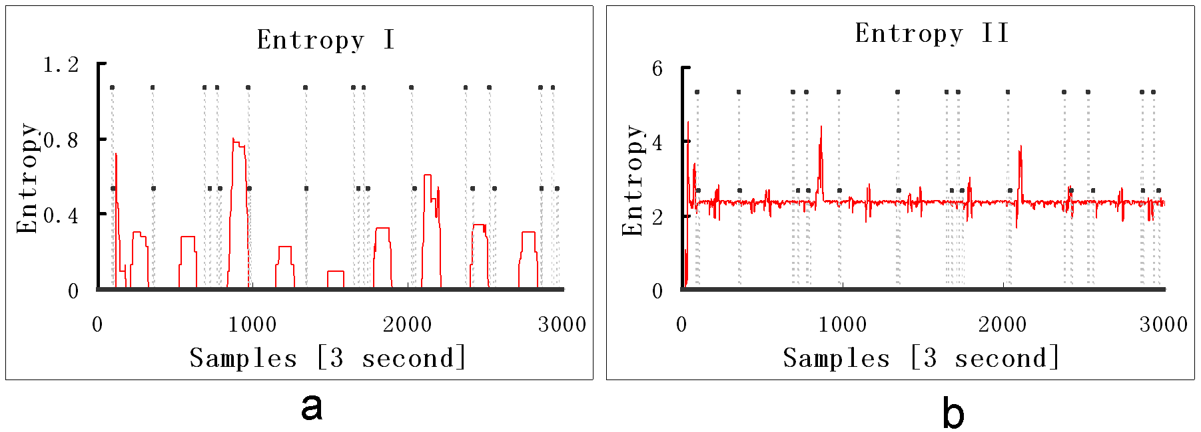
Entropy Time Series Processing
Entropy calculation done for every look back window results in an entropy time series
Examples
Sharp changes in the entropy timeseries is tagged as anomaly (or using 3-sigma rule if assuming normal dist.)
Visual analysis or signal processing can be used

Slide 54
Previous Threshold Definition
Gaussian/normal distribution assumed for data 68-95-99.7 rule
Fixed thresholds:

Slide 55
Remove Distribution Assumptions
Tukey Method
- No distribution assumption
- For individual values
Goodness-Of-Fit Method
- No distribution assumption
- test if current distribution complies with the normal distribution derived from history

Slide 56
Tukey Method
ltl
=
−
−
Observations falling beyond
3
Q
|
Q
Q
|
1
3
1
these limits are called
serious
utl
=
Q
+
3
|
Q
−
Q
|
outliers
3
3
1
+
−
≤
<
+
−
1
.
5
|
|
3
.
Q
Q
Q
x
Q
0
|
Q
Q
|
3
3
1
i
3
3
1
Possible
−
3
−
≤
<
−
−
Outliers
.
0
|
|
1
.
Q
Q
Q
x
Q
5
|
Q
Q
|
1
3
1
i
1
3
1
Upper Threshold: Q1 - k|Q3-Q1|
Lower Threshold: Q3 + k|Q3-Q1|

Slide 57
Goodness-of-Fit (GOF) Test
Look back window
History Distribution: P
Empirical Distribution: P1
Chi Square Goodness-of-Fit (P, P1)
Pass: Normal
Fail: abnormal

Slide 58
Experiment Results of EbAT
Value I | Near-optimum thresholds
Value II | Static thresholds
Entropy I
Entropy II
Entropy-based aggregation method I: using E1+E2+E3+E1*E2*E3
Entropy-based aggregation method II: using entropy of child entropies
Accuracy
False Alarm Rate
Value I
Value II
Entropy I
Entropy II
Value I
Value II
Entropy I
Entropy II
Average 57.4% improvement in accuracy and 59.3% reduction in false alarm rate

Slide 59
Experiment of Tukey and GOF
Accuracy
False Alarm Rate
Normal
Normal
Tukey
Tukey
GOF
GOF
Average 48% improvement in accuracy and 50% reduction in false alarms

