Slide 1
Mobile Computing in Cirrus Clouds: The Challenge of Intermittent Connectivity
Mostafa Ammar,
School of Computer Science
Georgia Institute of Technology
Atlanta, GA
In Collaboration with: Ellen Zegura, Mayur Naik, Irfan Essa, Cong Shi

Slide 2
Cirrus Clouds
Cirrus clouds are atmospheric clouds generally characterized by thin, wispy strands (wikipedia)

Slide 3
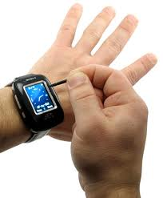
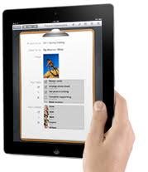
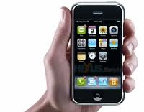
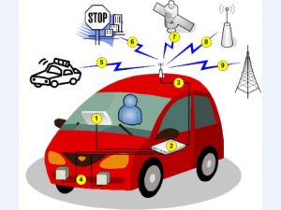
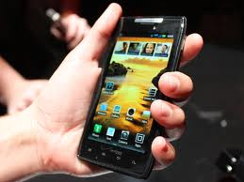
Connectivity and computing power on the go!
Notes:
We take forgranted our ability to be connected

Slide 4
Not long ago it was Science Fiction!

Slide 5
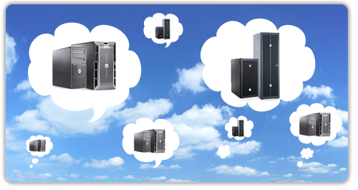
Cloud Computing
Computing resources delivered as a service over the Internet

Slide 6
Mobile Cloud Computing
Computing resources delivered as a service over the Internet
Extension of Cloud Computing to Mobile Services

Slide 7
Computing in Cirrus Clouds
Computing in settings of
Intermittent or variable connectivity
with smart use of all available resources for purposes of performance and/or power improvements

Slide 8
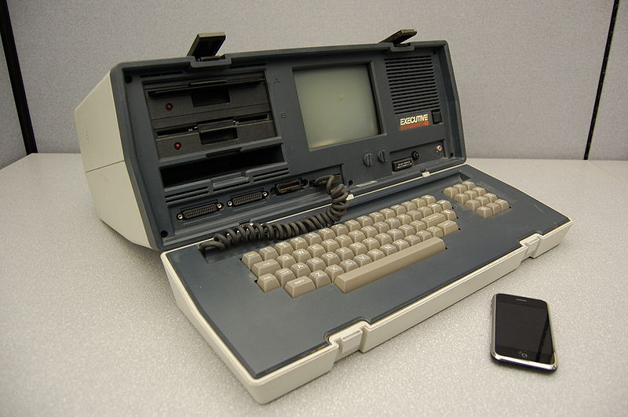
Motivating Context
Computation needs exceed mobile device capability
Increasingly capable mobile devices
Lots of idle resources
Collaborative/Replicated applications
Intermittent Connectivity

Slide 9
Mobile Application Examples
Pattern recognition for real-time decisions
e.g., friend or foe
Augmented reality
e.g., scene recognition engine (see next slide)
Collaboration for planning
e.g., scene stitching from disparate views
Citizen science
e.g., real-time traffic or weather information
Notes:
Fill in augmented reality example!

Slide 10
Video Segmentation

Slide 11
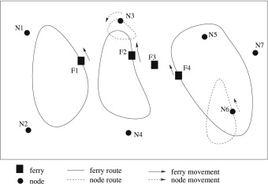
Intermittent Connectivity

Slide 12
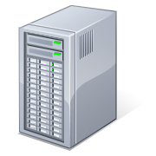
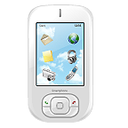
Traditional “Always-Connected” Central Cloud

Slide 13
Basic Premise
Intermittent and Variable Connectivity is an inherent feature of how mobile devices communicate with each other and with infrastructure.

Slide 14
Intermmittently Connected Central Cloud

Slide 15
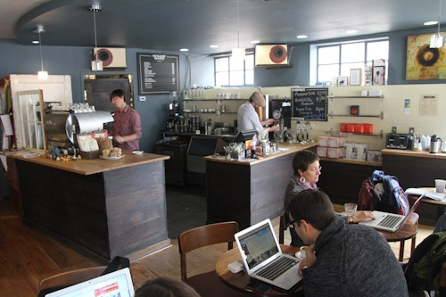
Cloudlet*
*M. Satyanarayanan, P. Bahl, R. Caceres, and N. Davies. The
case for VM-based cloudlets in mobile computing. IEEE
Pervasive Computing, 2009.

Slide 16
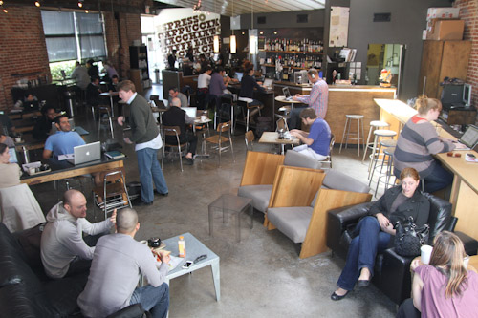
Intermittent Cloudlet

Slide 17
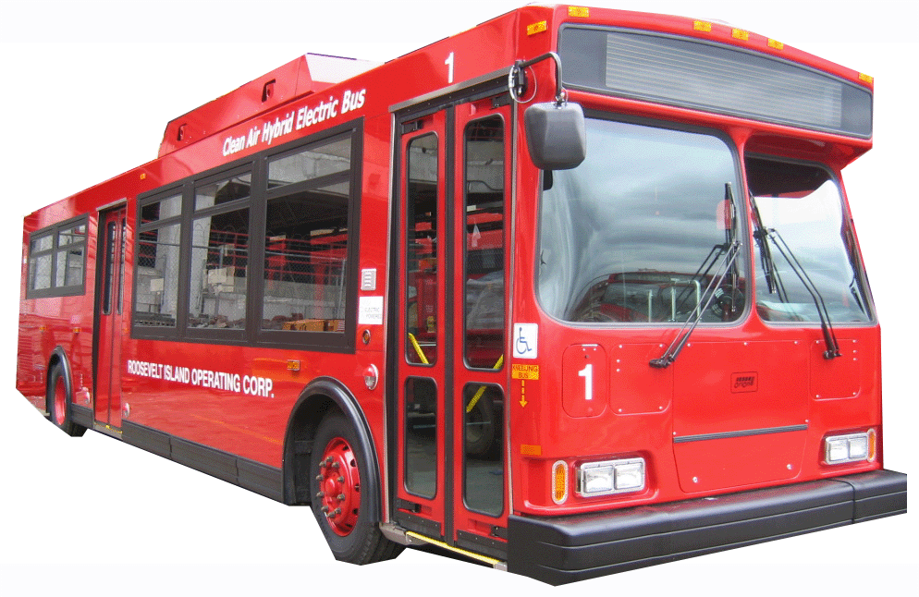
Computing Resources on The Move

Slide 18
Intermittently-Connected Mobile Devices*
*C. Shi, V. Lakafosis, M. Ammar, and E. Zegura. Serendipity:
Enabling remote computing among intermittently connected
mobile devices. In ACM MobiHoc, 2012.

Slide 19
Cirrus Cloud Computing Putting it all together

Slide 20
Specific Challenges
Handling Intermittent Connectivity
Short contact durations (need persistence and memory)
Randomness
Structuring Computation
Flexible, real-time computation partitioning
Computation Handoff and allocation
Other: Power, Incentives, Trust

Slide 21
What Hammers are Relevant?
Distributed computing on donated cycles,
in tightly coupled setting (e.g. Condor)
Cycles variable; network well connected
in loosely coupled setting (e.g., SETI@home)
Cycles variable; network variable
Disruption-tolerant/opportunistic networking
Routing with intermittent connectivity
Program analysis, run-time prediction

Slide 22
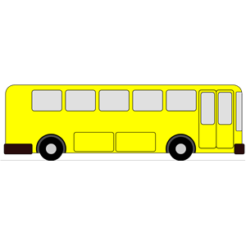
A Spectrum of Environments
2: Cloudlet
4: Peer
1: Cloud
3: Moving Infrastructure

Slide 23
Intermmittently Connected Central Cloud (IC-Cloud)

Slide 24
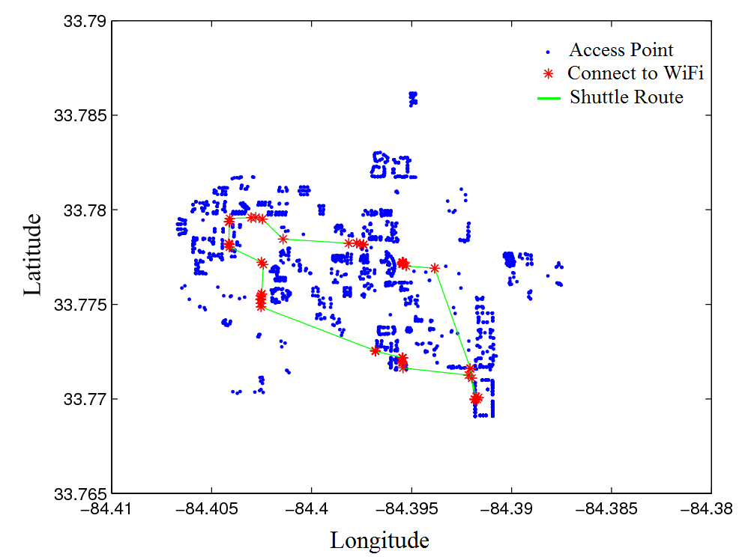
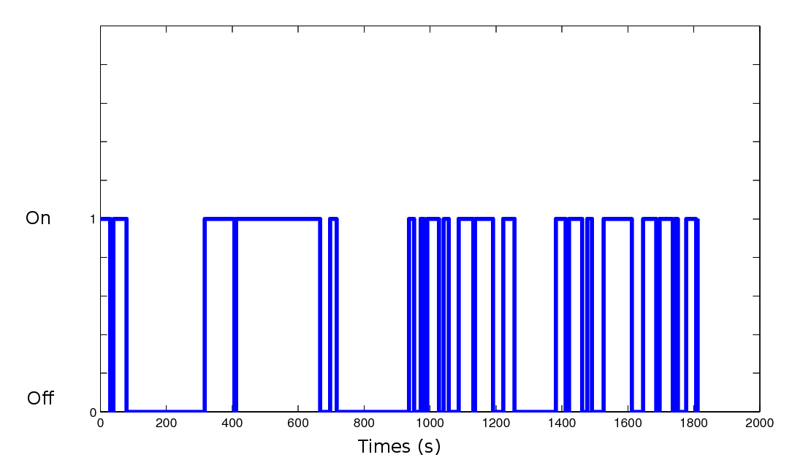
Intermittent Connectivity on Campus Shuttle

Slide 25
Example Results: Execution Time

Slide 26
In-Progress
Server Cost Considerations
Server Policy on disconnection
Cellular connectivity
Energy Considerations
Implementation and Deployment

Slide 27
A Spectrum of Environments
2: Cloudlet
4: Peer
1: Cloud
3: Moving Infrastructure

Slide 28
Serendipity
“We are the Cloud we have been looking for.”
*C. Shi, V. Lakafosis, M. Ammar, and E. Zegura. Serendipity:
Enabling remote computing among intermittently connected
mobile devices. In ACM MobiHoc, 2012.
Best Paper Award

Slide 29
Serendipity Executing Process
An unprocessed task
Processing a task
The task result

Slide 30
Task Dissemination
An unprocessed task
Processing a task
The task result

Slide 31
Task Dissemination and Executing
An unprocessed task
Processing a task
The task result

Slide 32
Result Collecting
An unprocessed task
Processing a task
The task result

Slide 33
Offloading in Serendipity
xfer?
local task
peer device
Connectivity may be unpredictable
Hedge bets, retain local control
Connectivity may be short
Ideal apps have large compute:xfer ratio
Some (many) devices will be energy limited
Both a constraint and an opportunity
Notes:
Delete devices?

Slide 34
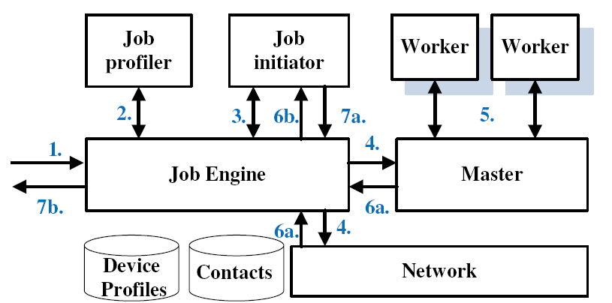
Serendipity Architecture
Job Execution Process
1. A user submits a job
2. Job profiler processes the job script
3. Job initiator schedules and monitors the job
4. Job engine allocates the job tasks to local and remote workers
5. Workers execute tasks
6&7. Job initiator collects and returns the results

Slide 35
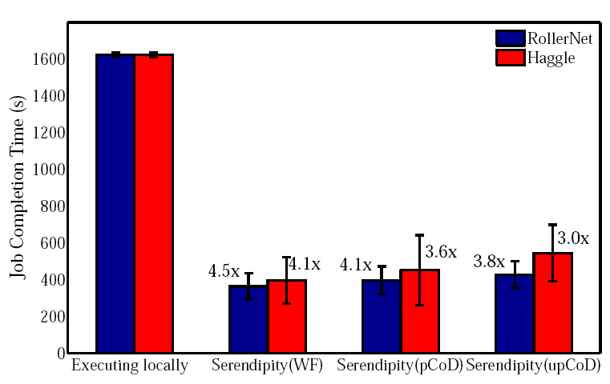
Serendipity’s Performance Benefit
Rollernet – 9 nodes, shorter contacts, more mobile
Haggle – 11 nodes, longer contacts, less mobile
100 speech-to-text tasks
Predictable w/o control
Unpredictable
Predictable w/control

Slide 36
Serendipity Prototype
Offload Task 2
Return results: detected faces

Slide 37
In-Progress
Implementation and testing
Power considerations

Slide 38
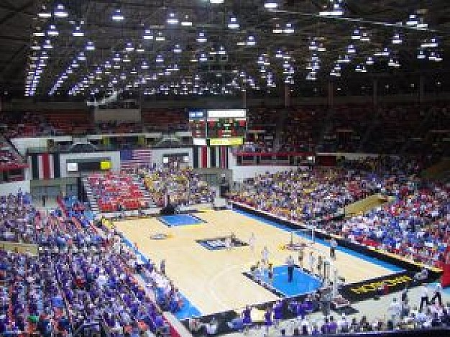
Supercomputers?

Slide 39
Summary
Intermittent or Variable Connectivity is a fact of life for mobile devices.
Cirrus Cloud Computing is a general framework for incorporating connectivity considerations.
Demonstrated challenges and opportunities.

Slide 40
Research Agenda
Consider Entire Range of Scenarios
Hybrid environment:
Choosing among options
Adapting over time
Video Streaming
Trust and Incentives
Application Programming and Deployment

Slide 41
Thank You!

